Slide 1
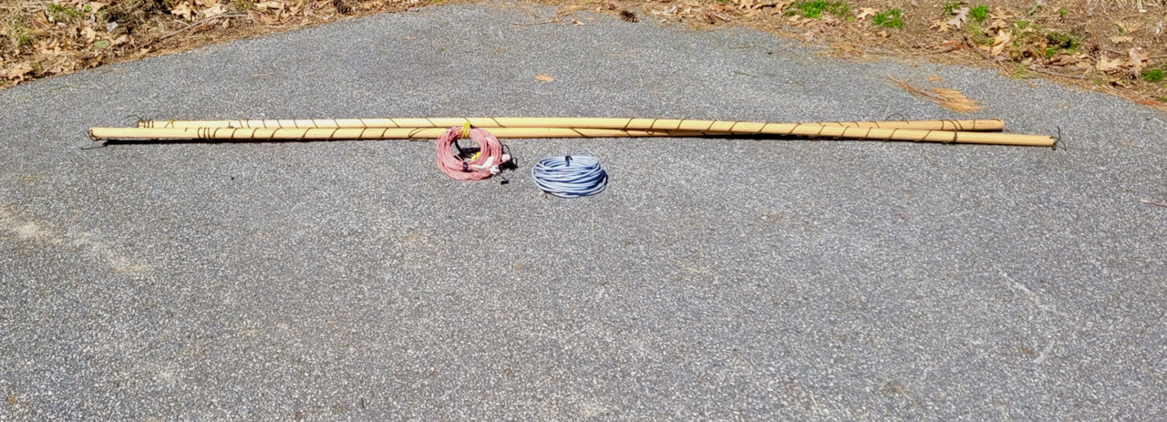
Portable 40M Beam
Bob Glorioso, W1IS, & Bob Rose, KC1DSQ
OCFMasters.com

Slide 2
Goals
Moveable on a Vehicle Roof or in a Van
Limits span to 10 ft or < 0.1 wavelength
Configuration Director - Driven Element, vs. Driven Element - Reflector
Good Forward Gain
Front to Back – Whatever we could get
Wires not aluminum tubing
Simple or no matching network

Slide 3
Layout SSB & CW
CW 64’ 4”
CW 68’ 9”

Slide 4
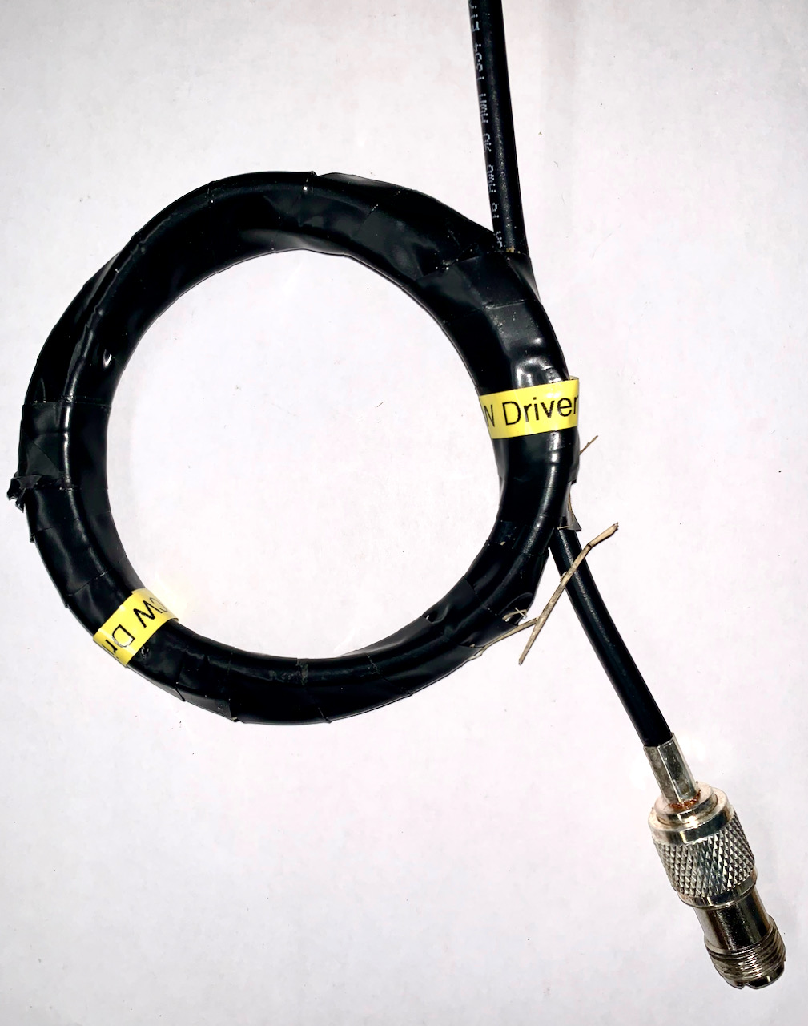
Simple Balun – 10 dB Isolation on 40M
5 Turns RG-8X, 5” diameter

Slide 5
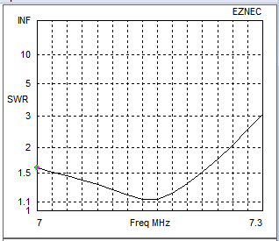
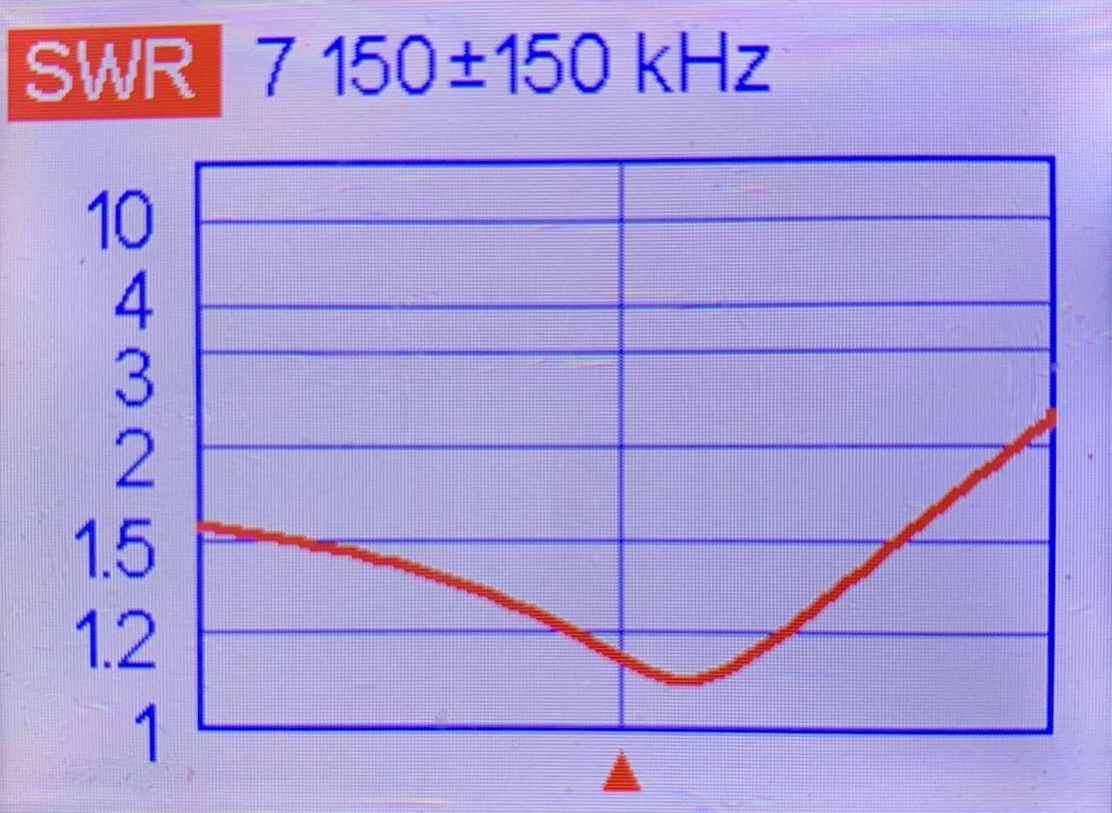
Matches 50 ohms Tuned for SSB
EZNEC Simulation
Antenna at 40’
Gain and F/B goes up above Min SWR
Gain 7.2dBi & F/B 5 dB at 7.05MHz & 8.4 dBi & 8.5 dB at 7.2MHz
Take-off Angle at 40’ is 40 degrees

Slide 6
How about CW?
Actual SWR Curve is Identical
Above 7.02 MHz Similar Gain and F/B to SSB

Slide 7
Tuning
SSB
Driven element dipole – min SWR at 6.8MHz
Add Director – Adjust for Min SWR at 7.16 MHz
CW
Driven element dipole – min SWR at 6.7 MHz
Add Director – Adjust for Min SWR at 7.02 MHz

Slide 8
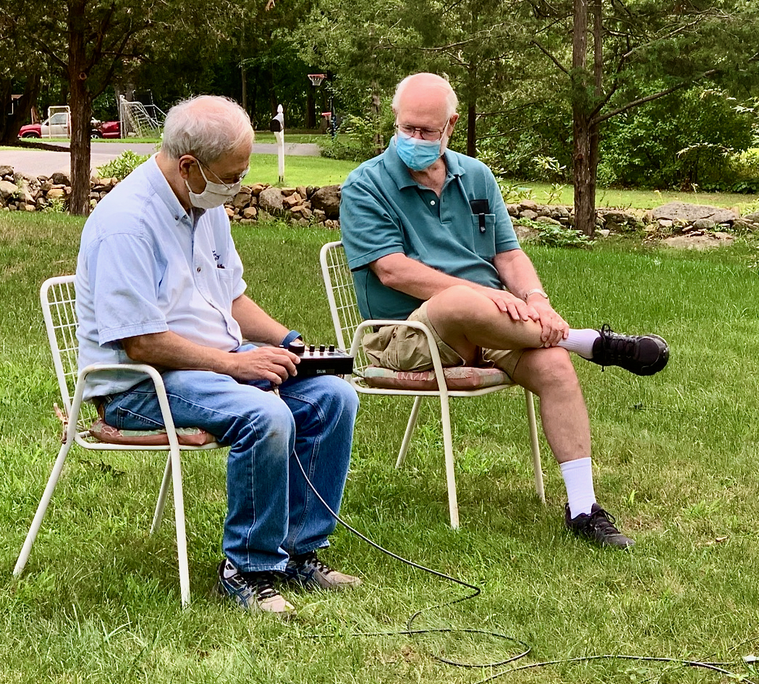
Testing

Slide 9
Antenna Stuff - ocfmasters.com Thank You

