Slide 1
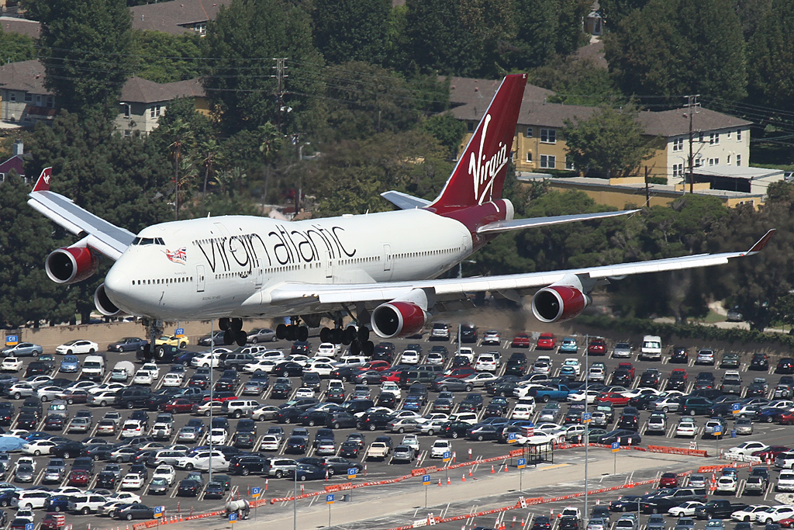
Plane Tracking for fun and profit (mostly fun) with ABS-B mode 1090 MHz transmissions
For: PART
Date: 10/17/17
KC1ELF
Tom Kavanaugh

Slide 2
Current ATC Tracking Method
What is ADS-B and why do we need it?
How it works
Getting Started
The “Profit” part
Antenna Building (The fun part)

Slide 3
Current ATC tracking methodology
Current method for ATC to establish aircraft position information
(Pre WW II)
Interrogation method, not automatic
Costly radar installations
More accurate positional techniques have been developed (GPS)

Slide 4
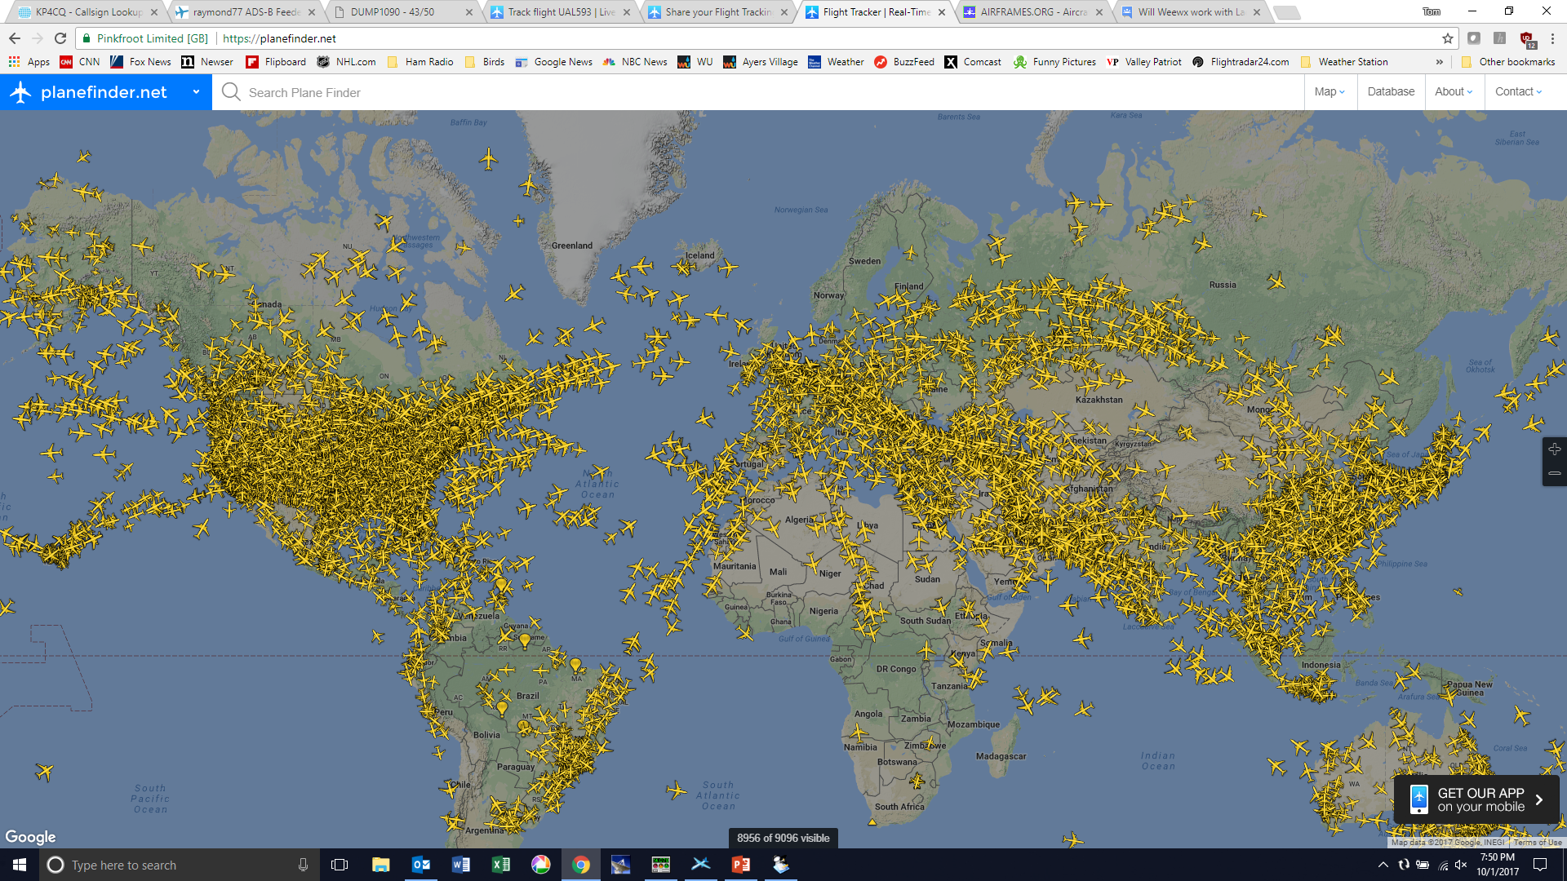
Why we might benefit from a more accurate ATC system?

Slide 5
What is ADS-B?
The Acronym
Automatic -It's always ON and requires no operator intervention
Dependent -It depends on an accurate GNSS signal for position data
Surveillance -It provides "Radar-like" surveillance services, much like RADAR
Broadcast -It continuously broadcasts aircraft position and other data to any aircraft, or ground station equipped to receive ADS-B

Slide 6
How it works
“New Technology”
Effective January 1, 2020
Is being rolled out now
1090 MHz
Non-encrypted transmission
Will be required for all aircraft flying above 18,000 ft or within 30 miles of a major airport

Slide 7
Getting Started with ADS-B Flight Tracking
$20 +

Slide 8
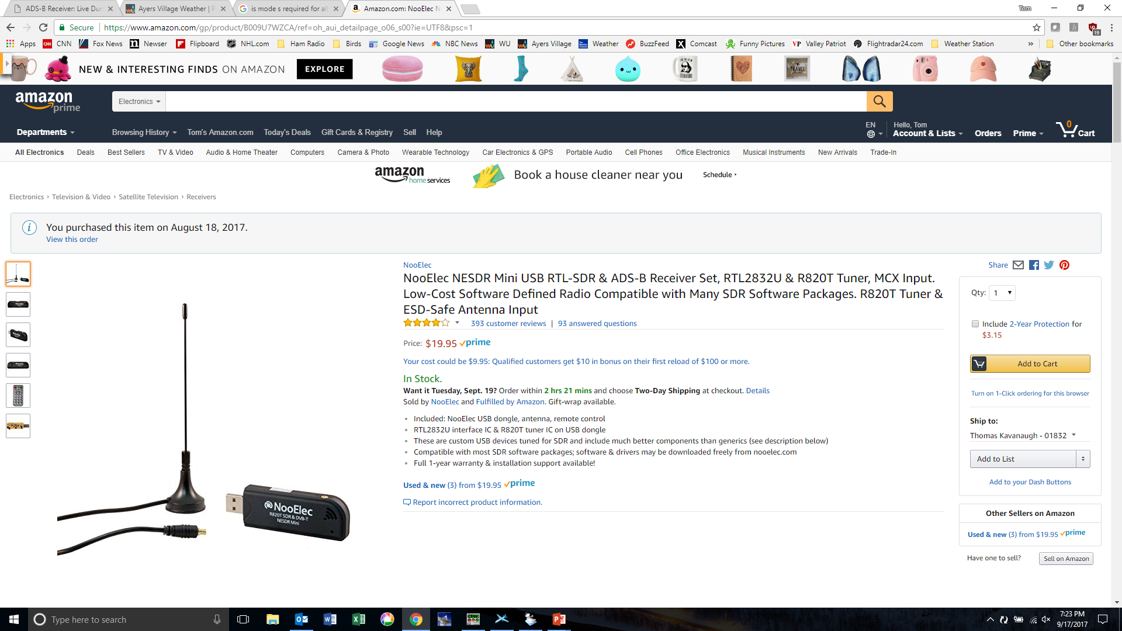
$20 SDR USB Dongle from Amazon
Flightaware dongle = same price, no antenna, but has 15db amp & 1090 MHz filter

Slide 9
Download the Tracking Software
Any of the following will work, each have different bells and whistles. I run different packages depending on what information I am interested in viewing
Linux
Dump 1090
Windows
Dump 1090
Virtual Radar Server
Plane Plotter

Slide 10
What you can track with ADS-B
Commercial Aircraft
Private Aircraft – Private Jets, Cessna’s, etc
Flying Cars
Military Aircraft (Not all for obvious reasons)
Helicopters
Balloons (Google Loon Project?)

Slide 11
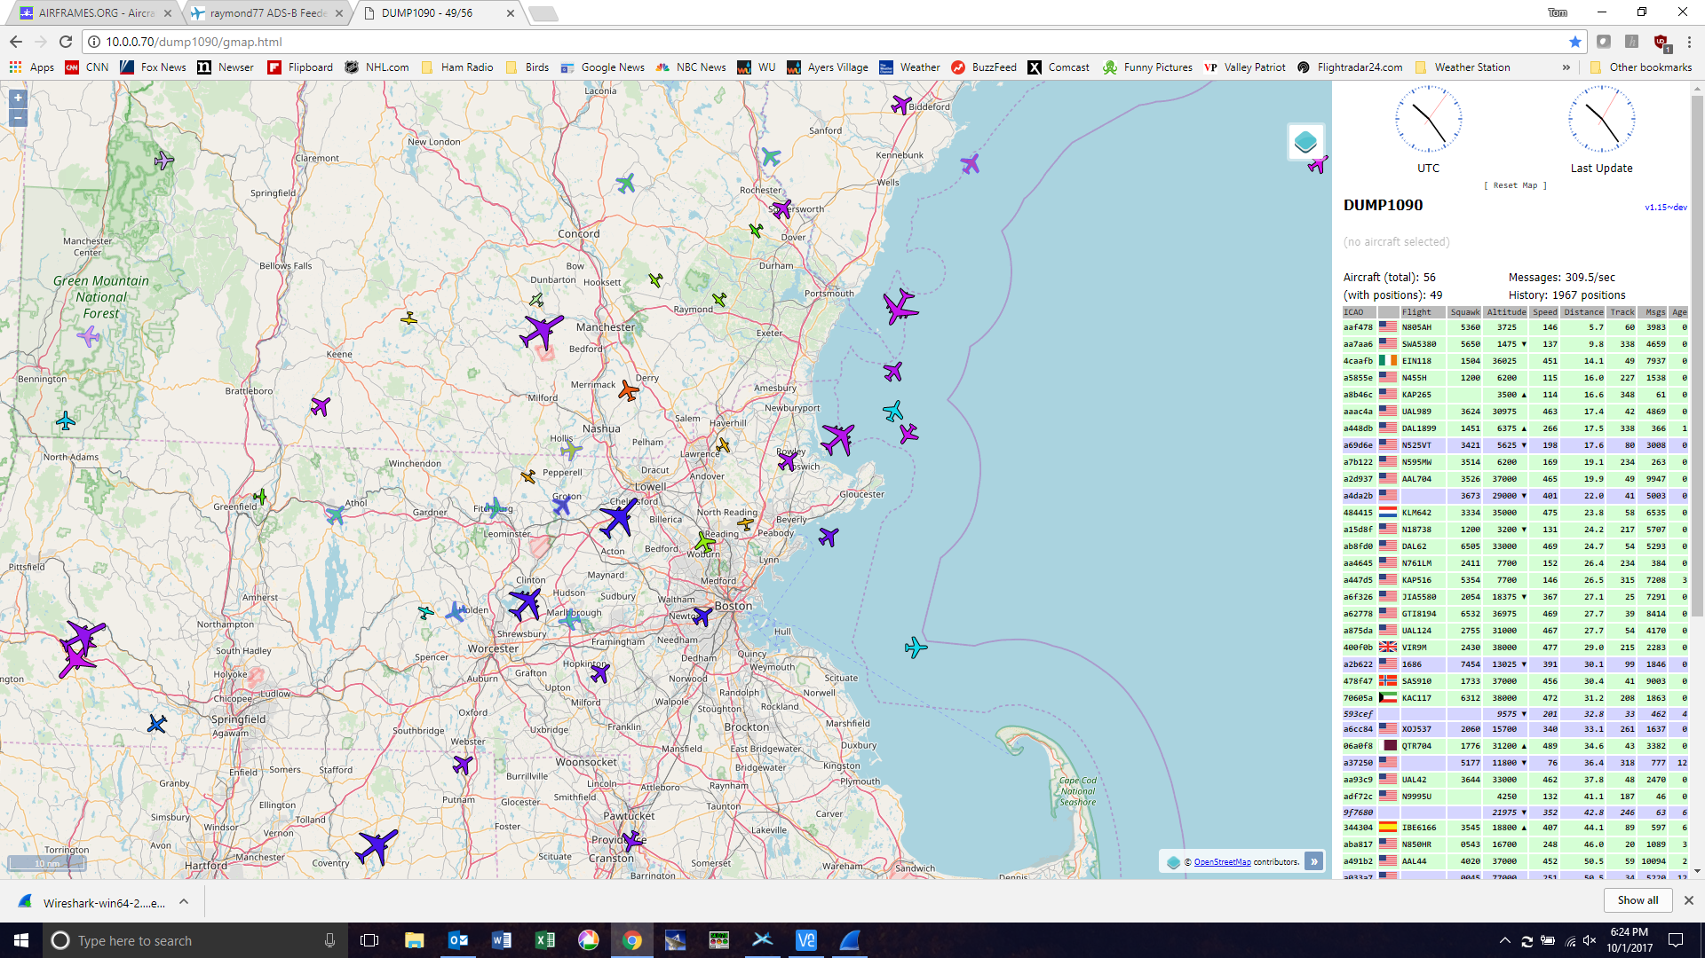
DUMP 1090 - Linux
Currently, only about 60-70% of commercial airliners have the ADB-S transponders installed. You will not be able to track every aircraft in the sky.

Slide 12
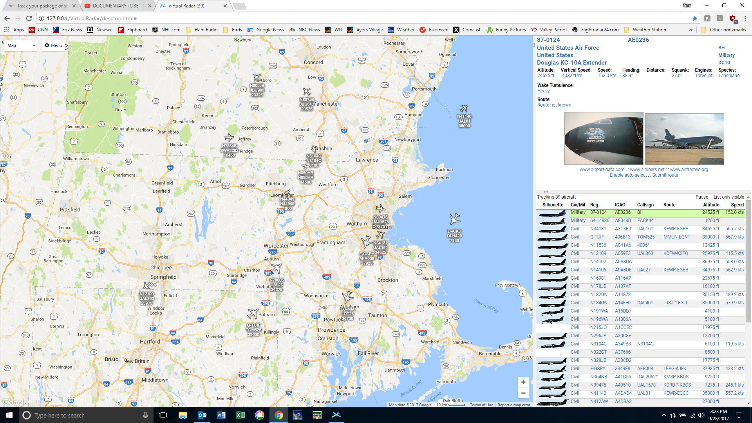
Virtual Radar - Windows

Slide 13
The “Profit” Part
Commercial sites that make a living off of displaying flights in real time on the web will compensate you for feeding your data to their sites. When you are installing the software, it will ask you which sites you want to feed.
These include:
Flightradar24.com – will upgrade you from a free account to a business account valued at $500/year
Flightaware.com – will upgrade you from a free account to an enterprise account, a $1080 per year value
*Also, feeding data to commercial sites will allow you to compare your stations with others for optimizing your set-up.

Slide 14
Antenna Considerations
To get “decent” range, you must improve the stock antenna
What is decent range?
ADS-B @ 1090 MHz are line of line of sight transmissions
Limitations
Curvature of the earth
Terrain around your location
Maximum range about 250 nautical miles
The “Good” thing is, that the transmitting stations are 30,000’ high
As with most things in radio optimizing your antenna is key!

Slide 15
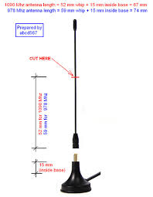
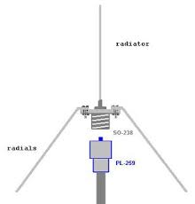
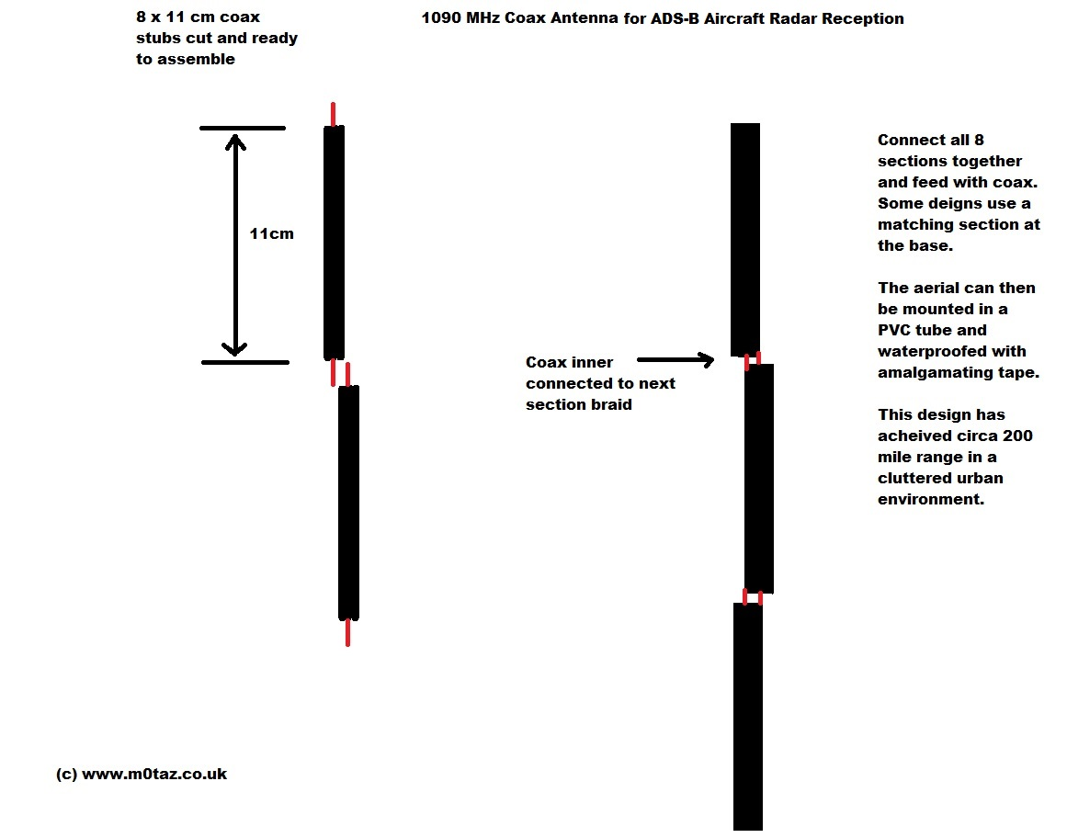
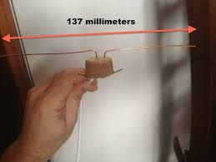
Antenna Building Options
Stock antenna Mod
The Spider
The Collinear
The Wine Cork
…but so far, the best results I have achieved is with………

Slide 16
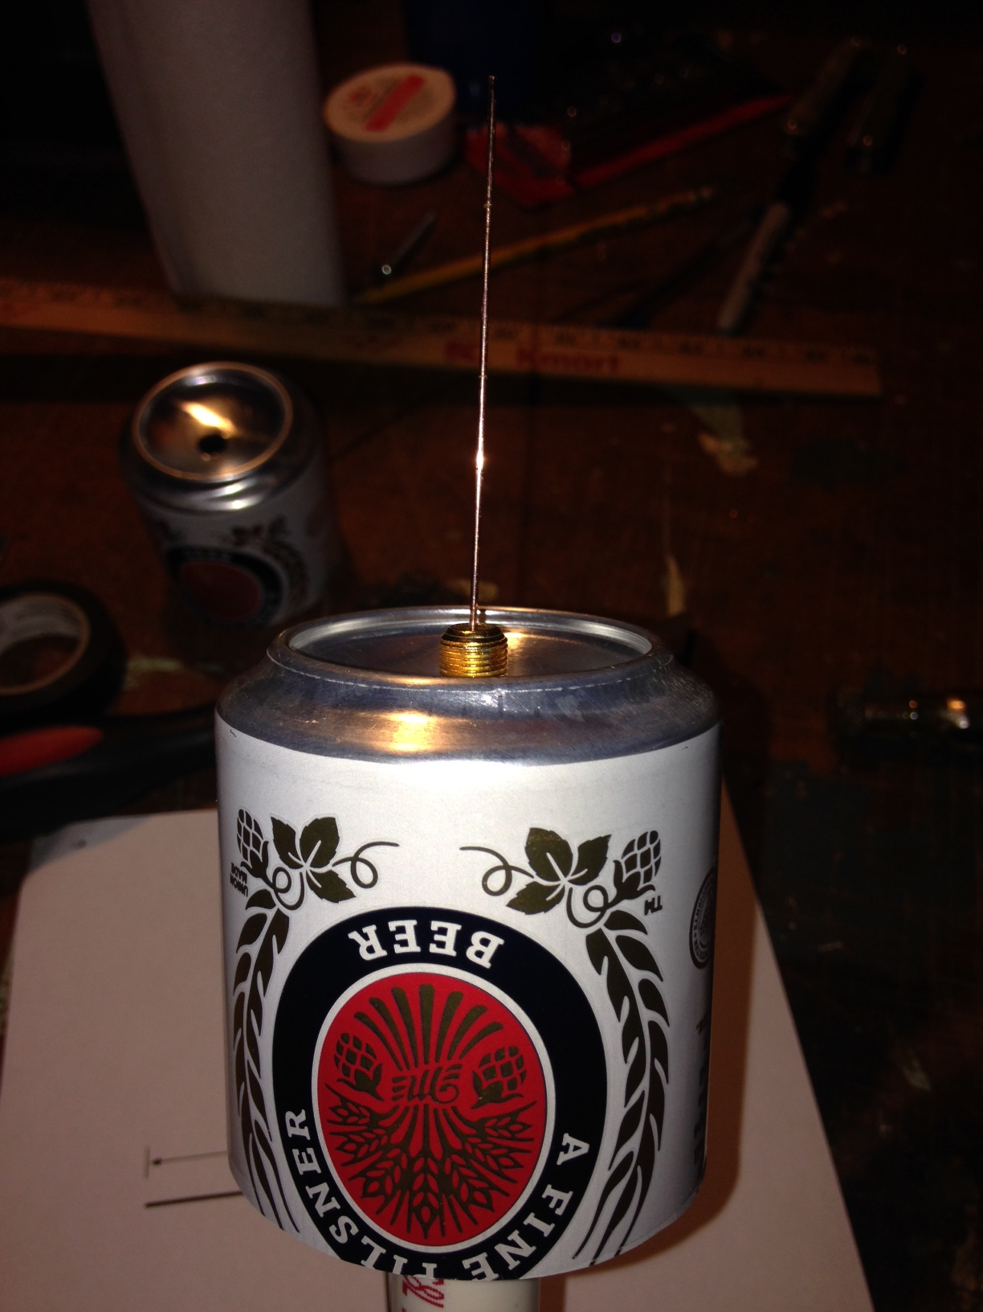
The Beer Cantenna!

Slide 17
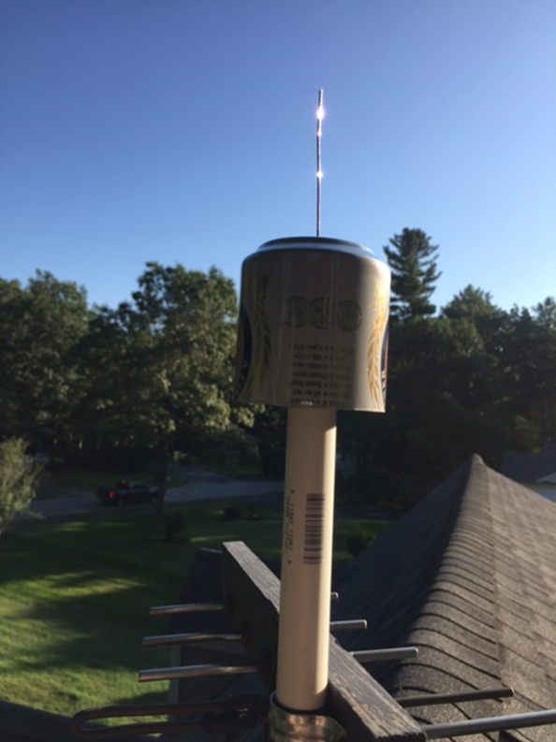
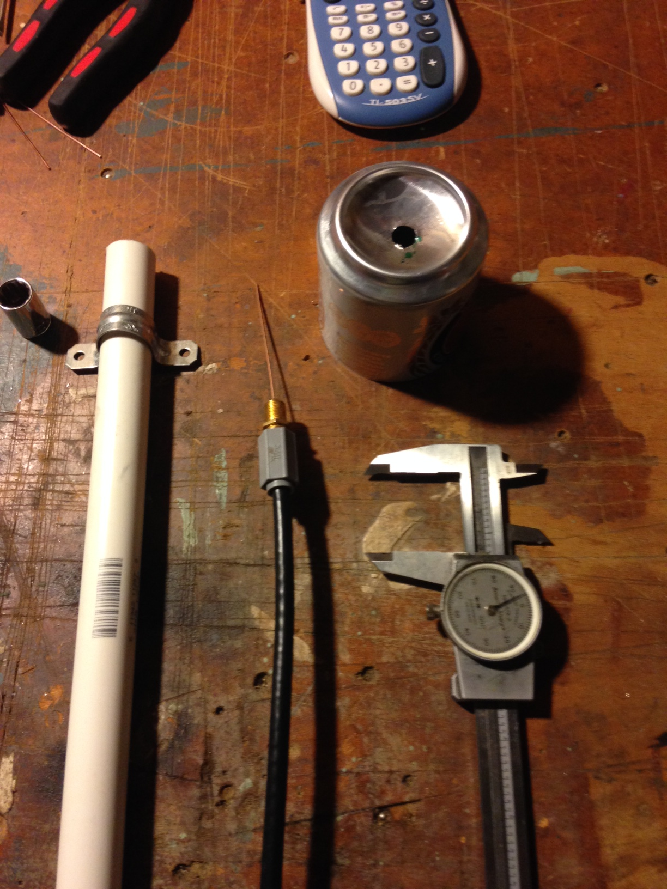
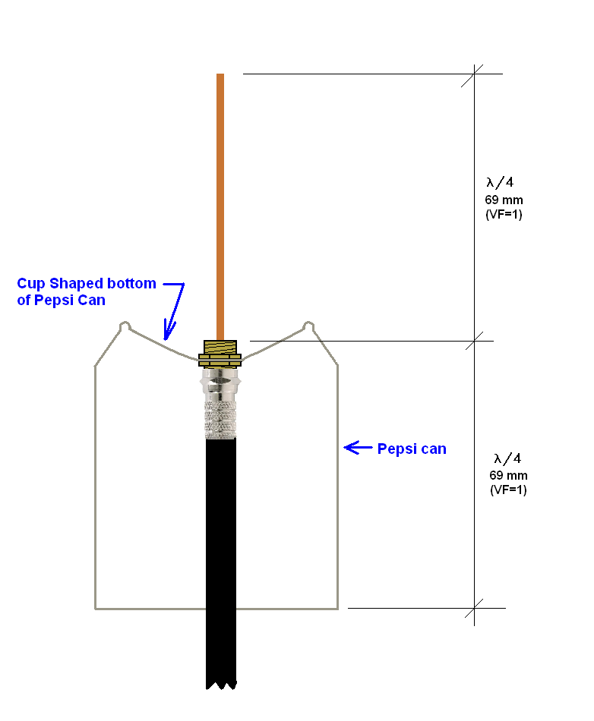
Basic build details
I’m using RG6 satellite coax (30’) with a 30db TV amplifier

Slide 18
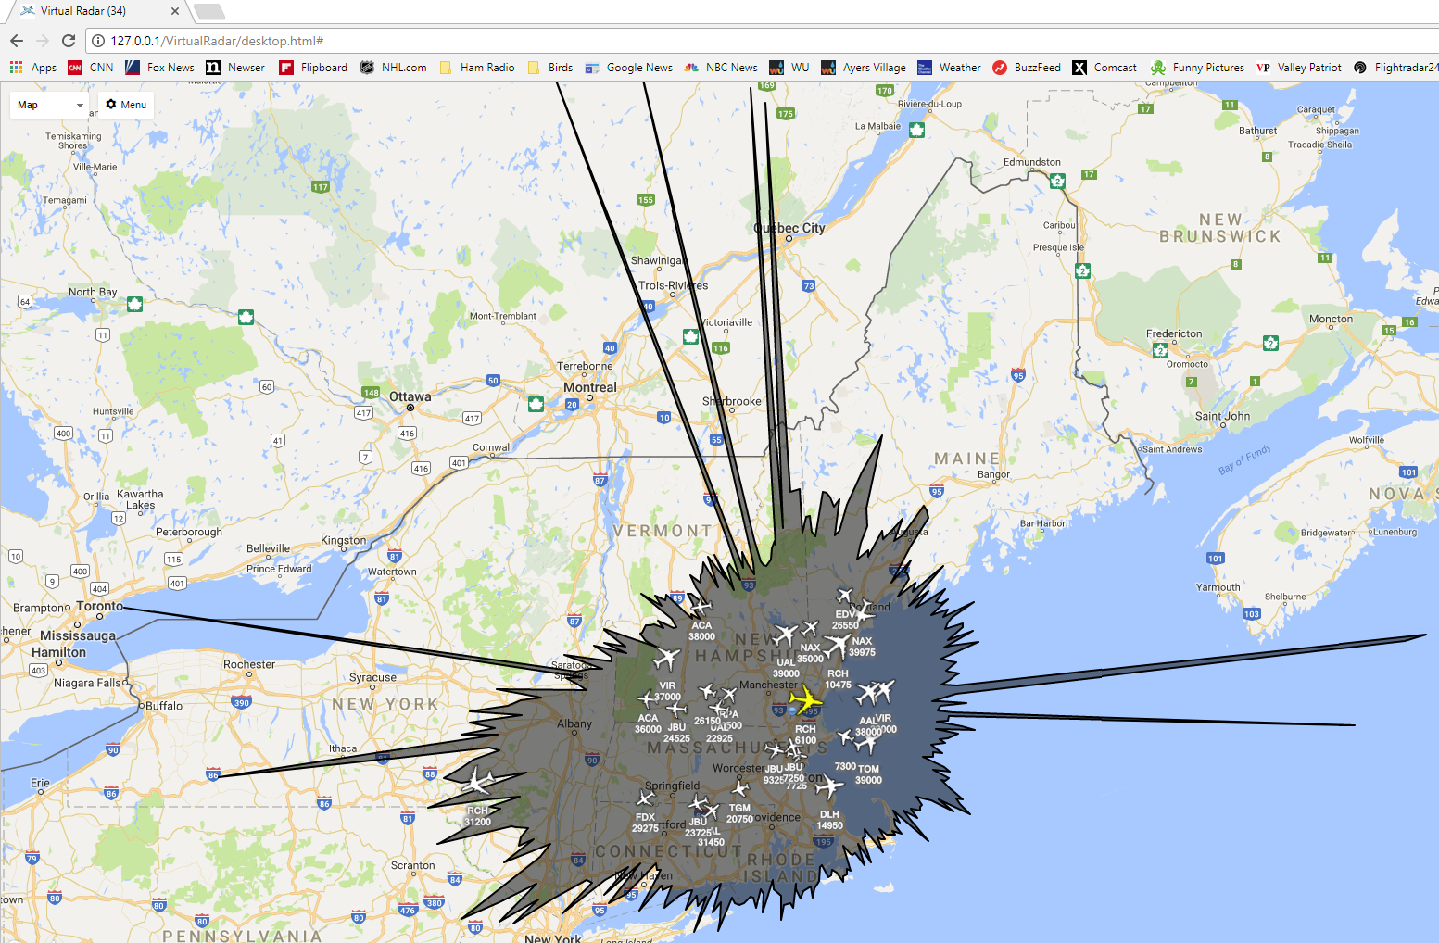
Statistics & Range
Maximum range = 193 Nm
Typical number of aircraft seen per day = 1,750
Typical number of positions reported per day = 135,000
Ducting?

Slide 19
Questions/ Suggestions?

