Slide 1
MESSAGE HANDLING
MESSAGE HANDLING
A Necessary Amateur Radio
Operator Skill

Slide 2
MESSAGE HANDLING
Message relay and the ARRL
The National Traffic System: its evolution
The Radiogram
Nets: Sending and receiving messages
Field Day
The NTS today and beyond

Slide 3
History of NTS
Message relaying during early 1900s
Founding of ARRL in 1914 to organize networks
With expanding demand following WWII NTS formed in 1949 using layers of nets following organized sequence and manned by many operators committing to at least one net session per week.

Slide 4
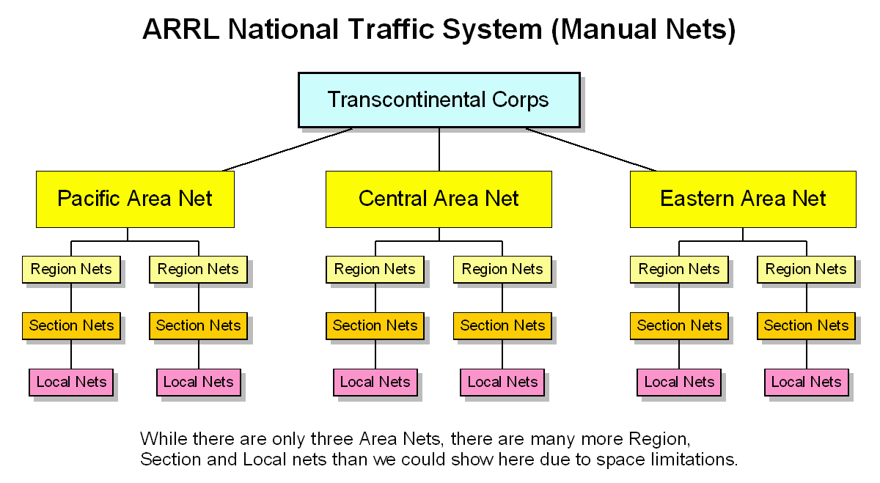
Traffic Routing
NTS traffic is passed using NTS nets operating on a specific schedule

Slide 5
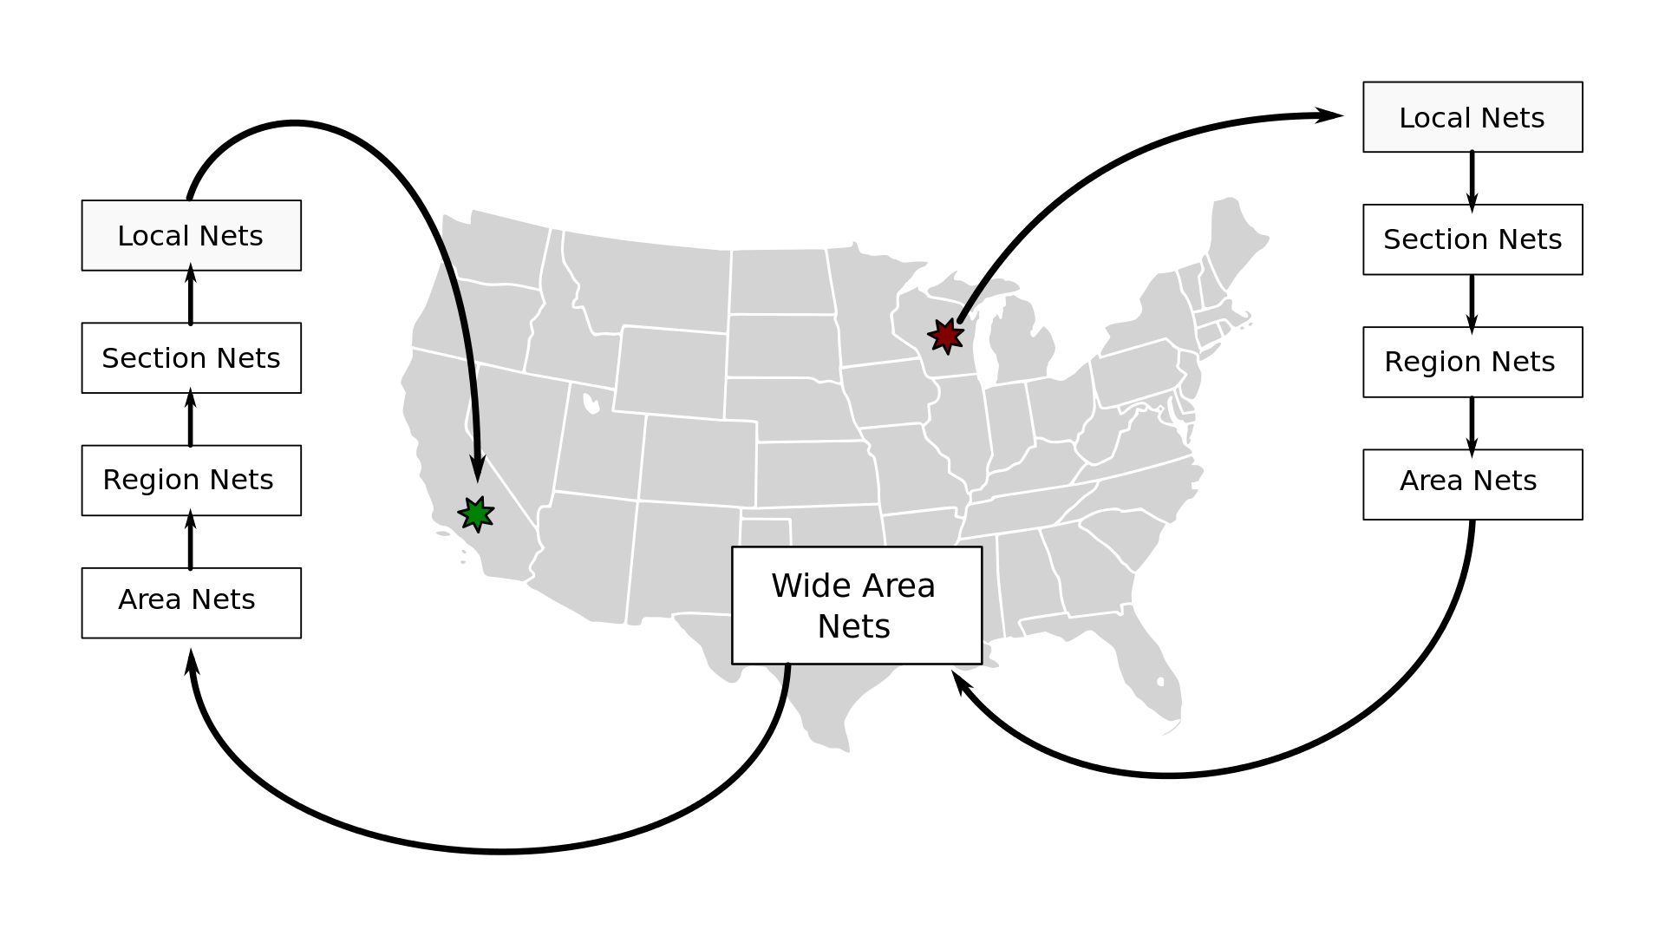
Traffic Routing
NTS traffic is passed using NTS nets operating on a specific schedule
Message originates here
at the LOCAL net
Message gets
delivered here
At the LOCAL net

Slide 6
Evolution of NTS
Nets originally all CW during evening hours, were expanded to include Sideband during afternoon. Followed same layers and sequencing as CW
Two meter FM local nets added to allow for more outlets for delivery
Digital modes added in 1980s and 1990s, operating 24/7 with auto forwarding and auto calling. Currently uses Pactor on HF and Packet on VHF
Radio email using WL2K introduced early 21st century

Slide 7
Basic Format for Radiograms
Format adaptable to ICS 213 Form
With addition of Header

Slide 8
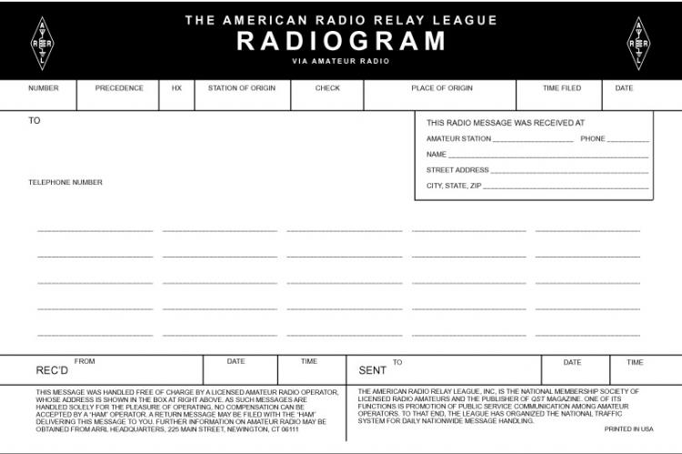

Slide 9
Four (4) Components of a Radiogram
Preamble or Header:
Address
Text
Signature
232 R HXG W1RVY ARL 10 SOUTHBRIDGE MA FEB 25
KRISTINE BATKA NX9K
8271 HOLLYWOOD ROAD
NEKOOSA WI 54457
715 886 4111
ARL FORTY SEVEN 2289 K1BML
FEB 24 1920 X 73
ERIC W1RVY

Slide 10
237 R G KC1CIC ARL 10 HULL MA FEB 16
LOREN S PIMENTEL N1IQI
5 EVAN RD
PEMBROKE MA 02359
781 925 0580
ARL FORTY SEVEN 856 W1RVY
FEB 16 2135 X 73
GREG KC1CIC
Message number is assigned by amateur originally formatting message. When sent on voice nets is read as “Number”. On CW nets and digital modes is sent as NR.

Slide 11
237 R G KC1CIC ARL 10 HULL MA FEB 16
LOREN S PIMENTEL N1IQI
5 EVAN RD
PEMBROKE MA 02359
781 925 0580
ARL FORTY SEVEN 856 W1RVY
FEB 16 2135 X 73
GREG KC1CIC
Precedence establishes order of priority
Emergency handled first, followed by Priority, then Welfare, finally Routine
Most messages will be Routine voiced on voice nets as “routine” and sent on CW nets and digital modes as “R"

Slide 12
237 R G KC1CIC ARL 10 HULL MA FEB 16
LOREN S PIMENTEL N1IQI
5 EVAN RD
PEMBROKE MA 02359
781 925 0580
ARL FORTY SEVEN 856 W1RVY
FEB 16 2135 X 73
GREG KC1CIC
Handling instructions to delivering station HXA thru HXG
Most commonly seen:
C=report delivery time, date to originator; E=ask recipient for return reply; F#= hold for delivery on # date, G=if delivery expense required can be serviced back to originator

Slide 13
237 R G KC1CIC ARL 10 HULL MA FEB 16
LOREN S PIMENTEL N1IQI
5 EVAN RD
PEMBROKE MA 02359
781 925 0580
ARL FORTY SEVEN 856 W1RVY
FEB 16 2135 X 73
GREG KC1CIC
Call sign of amateur formatting radiogram for transmission.

Slide 14
237 R G KC1CIC ARL 10 HULL MA FEB 16
LOREN S PIMENTEL N1IQI
5 EVAN RD
PEMBROKE MA 02359
781 925 0580
ARL FORTY SEVEN 856 W1RVY
FEB 16 2135 X 73
GREG KC1CIC
Place of origin where message originated, ie location of signee, not necessarily location of station of origin

Slide 15
237 R G KC1CIC ARL 10 HULL MA FEB 16
LOREN S PIMENTEL N1IQI
5 EVAN RD
PEMBROKE MA 02359
781 925 0580
ARL FORTY SEVEN 856 W1RVY
FEB 16 2135 X 73
GREG KC1CIC
Date of message expressed as three letter month code and date,
Note year omitted
Not expressed as all numerical ie 3/2

Slide 16
237 R G KC1CIC ARL 10 HULL MA FEB 16
LOREN S PIMENTEL N1IQI
5 EVAN RD
PEMBROKE MA 02359
781 925 0580
ARL FORTY SEVEN 856 W1RVY
FEB 16 2135 X 73
GREG KC1CIC
Name, with call sign if amateur, address including zip code and phone # as complete as possible
Email address may also be added following phone number

Slide 17
237 R G KC1CIC ARL 10 HULL MA FEB 16
LOREN S PIMENTEL N1IQI
5 EVAN RD
PEMBROKE MA 02359
781 925 0580
ARL FORTY SEVEN 856 W1RVY
FEB 16 2135 X 73
GREG KC1CIC
Text as concise as possible, preferably 25 words or less
ARRL numbered radiogram texts can be used to abbreviate texts. If used note “ARL #” in check
Number words in text should match number in check box
Letter X used for period as needed, voiced as “xray”

Slide 18
237 R G KC1CIC ARL 10 HULL MA FEB 16
LOREN S PIMENTEL N1IQI
5 EVAN RD
PEMBROKE MA 02359
781 925 0580
ARL FORTY SEVEN 856 W1RVY
FEB 16 2135 X 73
GREG KC1CIC
Signature not shown on form. Should be inserted at bottom of text.

Slide 19
Sending Messages
Now that I have a message what can I do with it?

Slide 20
Traffic Modes
NTS traffic is passed using various operating modes and bands
The primary means to pass traffic are:
CW Nets using HF Frequencies
Phone Nets using VHF and HF Frequencies
In parallel with the Traffic Nets are the Digital Traffic Stations
Packet at VHF Frequencies
Pactor at HF Frequencies
Digital traffic operates 24x7

Slide 21
Local Traffic Nets
Eastern and Central MA
LOCAL NTS Nets take traffic and pass it to higher level nets
MARIPN Phone HF 6:00pm Tue, Thu, Sat
MARICW CW HF 7:00pm Daily
CITN Phone VHF 7:30pm Mon, Tue, Thu, Sat
EM2MTN Phone VHF 8:00pm Daily
CM2MTN Phone VHF 9:00pm Daily
HHTN Phone VHF 10:00pm Sun, Mon, Wed, Fri
These local nets handled a total of 3450 messages in 2016!

Slide 22
Local Digital Traffic
Eastern and Central MA
All digital traffic in MA routes through KW1U MBO
The Digital Relay Stations (DRS) put and take traffic only to the MBO
The MBO and DRS pass traffic to and from the LOCAL nets as needed
MBO
KW1U
DRS
DRS
DRS
DRS
DRS
DRS
N1IQI W1RVY KC1CIC KC1EGK KO4W KC1ETB
These local digital stations handled a combined total of 12,738 messages in
4th quarter 2016!

Slide 23
Checking In
Listen.
Check-in instructions are given at beginning of section and local nets.
Follow instructions of Net Control (NCS). He/She is the “boss”.
Remain on net until “excused”.

Slide 24
Sending Traffic
When instructed by NCS, check if receiving station is ready to copy
Send slowly enough for receiving station to copy. Imagine yourself writing as you speak.
Pause briefly at “Break” before and after text for any fills needed. If none requested, continue.
Feel free to ask for help as needed. We have all been new at this at one time.

Slide 25
Copying Traffic
Don’t be embarrassed to ask sending station to send slowly or to slow down.
When sending station “breaks” following address and text or at end of message, ask for any “fills” needed such as “confirm”, “word after”, “word before”, “all between”, etc.
At end of message confirm number of words copied with check count in preamble.
“Roger” message when certain you have copied accurately.

Slide 26
Tips for Delivery
We are representing Amateur Radio to the public.
Introduce yourself as an amateur radio operator with a free greeting from (name) in (place of origin).
Do not read the preamble. Read only the message and signature.
Translate any ARL numbered radiograms.
Offer to send a reply to sender. Get address/phone info.
If message is undeliverable send service message to originator station using ARL Sixty Seven.

Slide 27
Why NTS?
Public service per FCC Part 97 one of reasons for existence.
Training for emergencies, handling “record” messages.
Traffic nets are excellent venues to practice and hone net skills
Working as an NCS provide additional net leadership skills and experience
The many modes used to conduct traffic nets also allows participating operators the experience to work different modes
The training and experience operators get by participating in NTS means they are ready to handle emergency traffic when the emergency occurs. Ramp up time and mistakes are significantly reduced.

Slide 28
FIELD DAY MESSAGES
Points given for NTS messages
Must be in proper format, sent via RF
Can be sent via
Traffic nets (times and frequencies on website
nts.ema.arrl.org), or
VHF Packet to KW1U-1 145.09 Mhz 24/7 or
HF Pactor to KW1U 24/7 3591.4 Khz Center fq

Slide 29
Digital Message Format
ST xxxxx @ NTSzz < (call sign of stn of origin)
Xxxxx = zip code zz = state code (ie NTSMA)
Must be space between < and call sign
(Subject line) City/town Phone area code
Message
/ex (to indicate end of message)

Slide 30
Example
ST 01742 @ NTSMA < W1ABC
CONCORD 978
NR 232 R HXG W1RVY ARL 10 SOUTHBRIDGE MA FEB 25
KRISTINE BATKA NX9K
8271 HOLLYWOOD ROAD
NEKOOSA WI 54457
715 886 4111
BT
ARL FORTY SEVEN 2289 K1BML
FEB 24 1920 X 73
BT
ERIC W1RVY
/EX

Slide 31
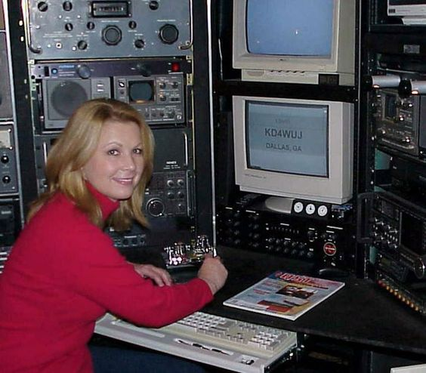
Status of NTS
Where do we go from here?

Slide 32
QUESTIONS?

