Slide 2
Field Day 2019
June 22 – 23
Concord Rod & Gun Club, Concord, MA
AKA, “Hail, hail, the gang’s all here!

Slide 3
Highlights of Field Day 2019
75 attendees.
Thunder, lightning, and hail.
Efficient setup & teardown.
24 hour operations by CW and Phone
1,296 valid QSOs. Fewer contacts than last year, but more states. Inconsistent propagation.
First use of FT-8. Twice as many Digital QSOs as last year.
Army National Guard visit.

Slide 4
Stations & Leads
Digital
Rich, AB1HD
Satellite
Bob, KB1SWZ
Rob, KE8UW
CW
Bob, W1IS
VHF/10 Meters
Allison, KB1GMX
Messaging
George, K1IG
John, WB2OSZ
Phone
George, K1IG
GOTA
Andy, KB1OIQ

Slide 5
Infrastructure Leads
HF Antennas
Bob, W1IS
Food
Charlie, W1ADL, Rick, W1RAG, Lela, KC1ACV, Lyman, W1LKS
Media & PR
Lela, KC1ACV
Safety
Dale, KB1ZKD
Finance
Alan, W1AHM
Signage
Alan, W1AHM
Site Liaison
Dale, KB1ZKD

Slide 6
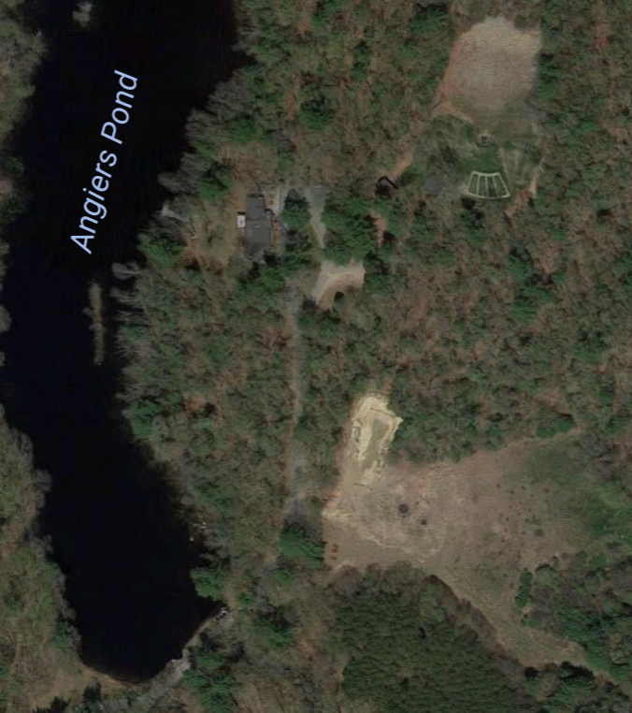
Site Plan Antenna locations are approximate
CW
Digital
VHF/10
Satellite
GOTA
N
500 ft
Phone

Slide 7
QSO Statistics

Slide 8
Contact Rate
Rain
& Hail
Dinner
Average almost 1/minute for 24 hours
Morning Crew

Slide 9
Contacts Per Band
Band

Slide 10
Contacts Per Station
Band

Slide 11
Maps
50 States
83 Sections (Including Canada)
Worked
Not Worked

Slide 12
VHF/10 Meters
37 Contacts
10 States
11 Sections
10
Worked
Not Worked

Slide 13
Digital
120 Contacts
26 States
34 Sections
Worked
Not Worked

Slide 14
GOTA
24 Contacts
12 States
14 Sections
12 Operators
Worked
Not Worked

Slide 15
Phone
521 Contacts
44 States
63 Sections
Worked
Not Worked
VI PR

Slide 16
CW
614 Contacts
48 States
70 Sections
Worked
Not Worked
VI

Slide 17
Total
1,296 Contacts
48 States
69/71 US Sections
Worked
Not Worked
PR, VI

Slide 18
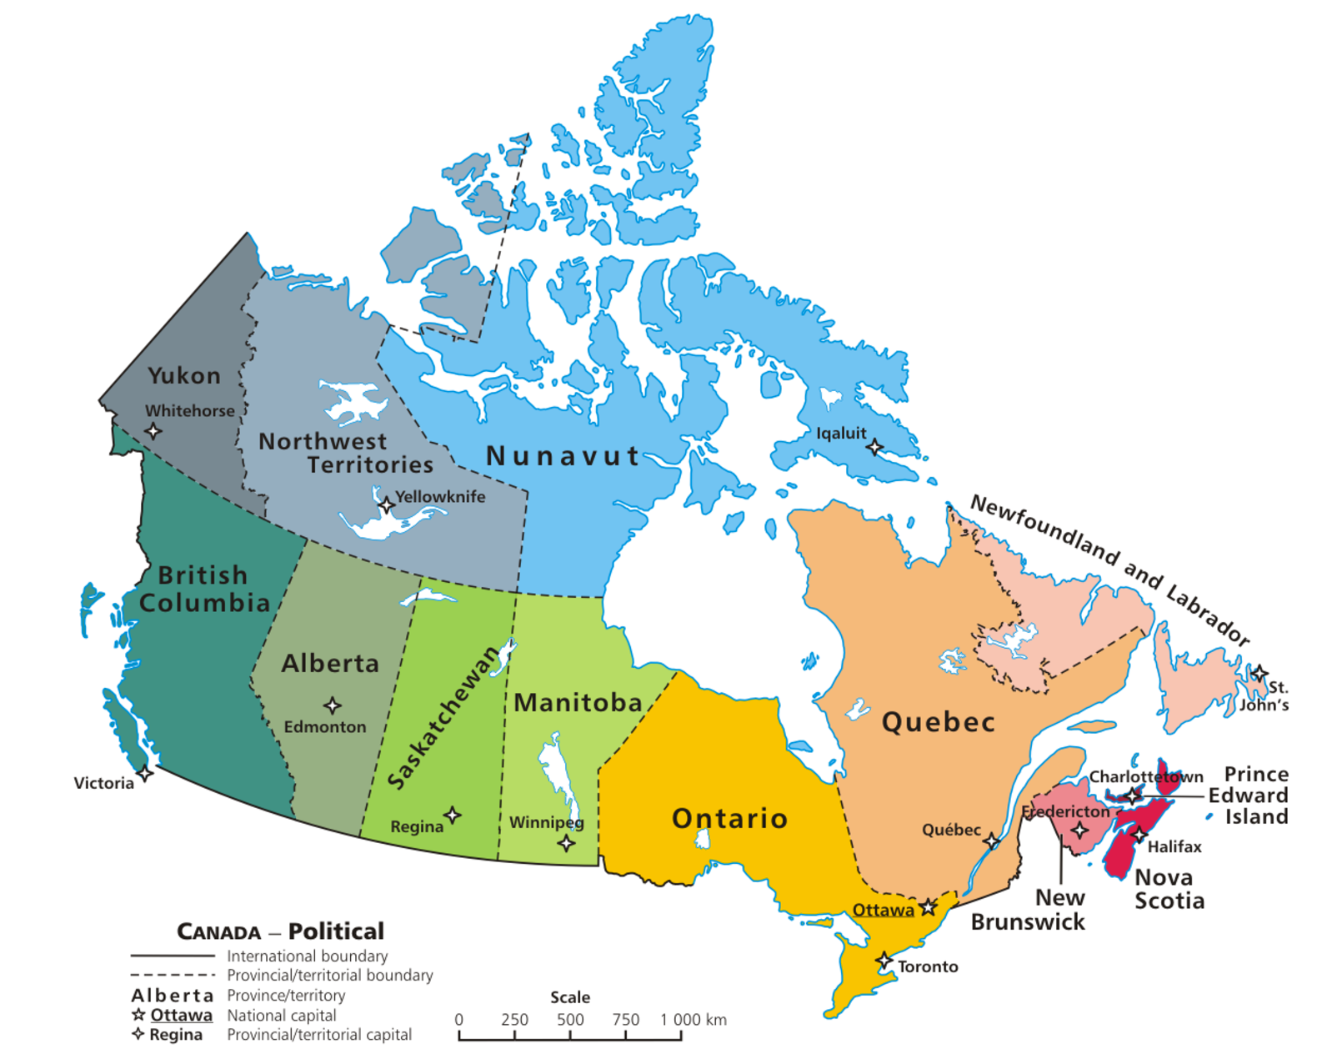
Canadian Sections Total
72 Contacts
7/12 Canadian Sections
Worked
Not Worked

Slide 19
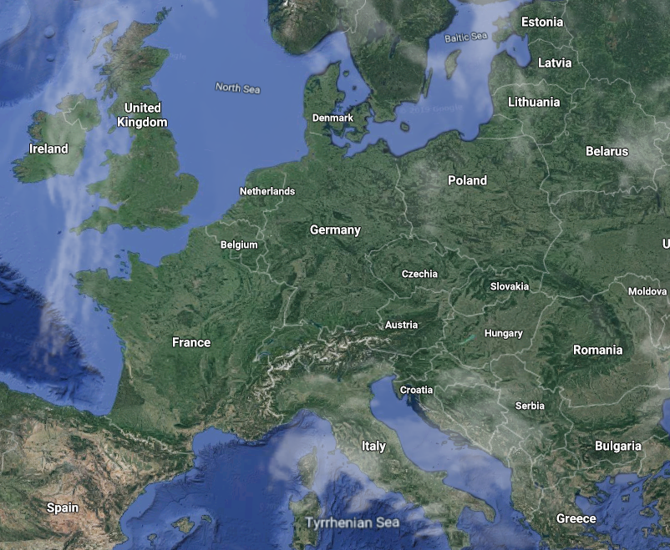
DX
Mike, W1BX
20M CW
YU5R
4,384 Miles

Slide 20
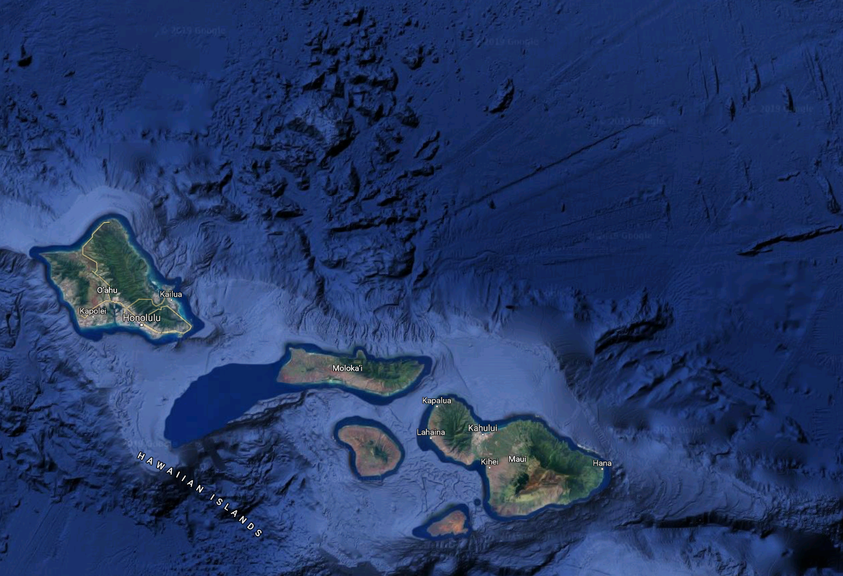
Best DX
KH6J
5,052 Miles
Andy, KB1OIQ
20M CW
KH6RS
5,009 Miles
Colin, W1DJR
Bonnie, KC1JTQ
40M Phone
Alan, W1CCE
20M CW

Slide 21
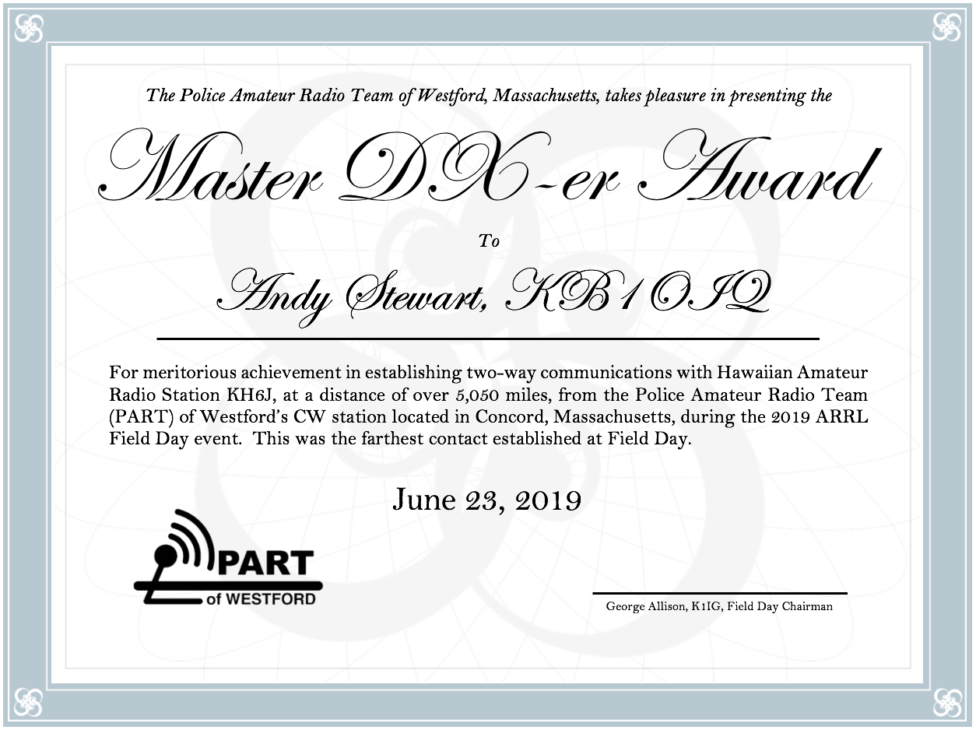
DX Award

Slide 22
Bonus Points
✔
✔
Emergency Power
Media Publicity
Satellite QSO
Alternate Power
W1AW Bulletin
Educational Activity
Youth Participation
Web Submission
Public Location
Public Info Table
Site Visit by Elected Off.
Site Visit by Agency Rep
Message Handling
Message to Section Mgr.
GOTA Bonus
Social Media
Safety Officer
✔
✔
✔
✔
✔
✔
✔
✔
✔
✔
✔
✔
✔
1,710 Bonus Points!

Slide 23
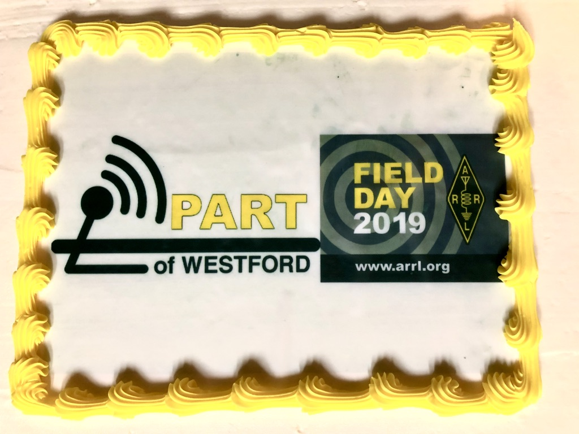
Food Bonus Points
Team Lead Charlie, W1ADL
Lyman, W1LKS
Lela, KC1ACV
Rick, W1RAG

Slide 24
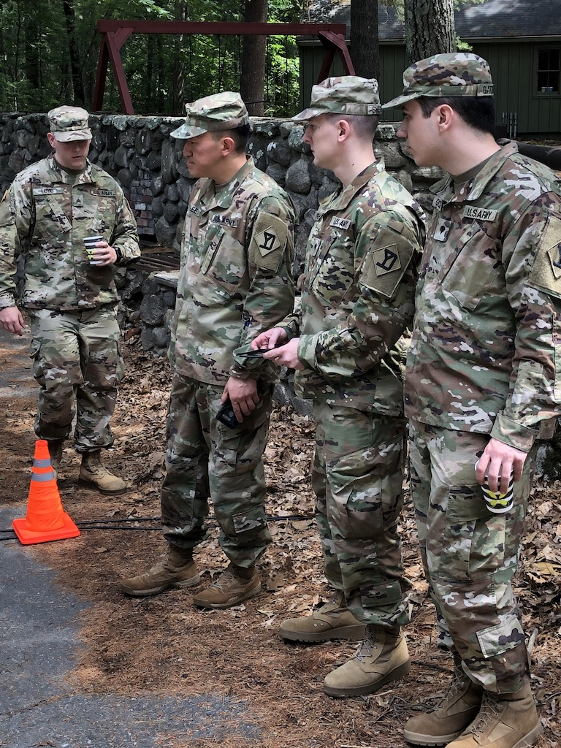
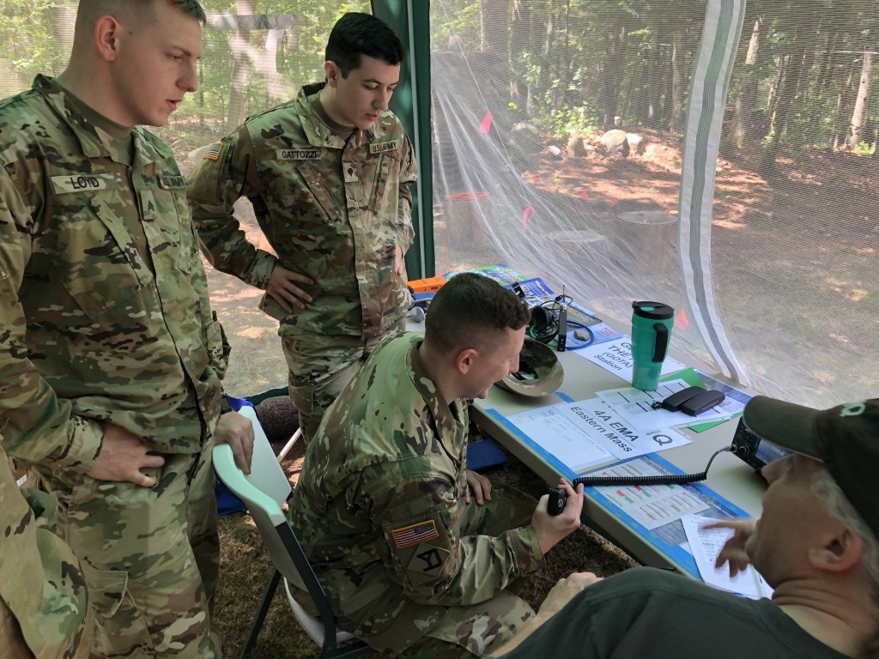
Visitors
211th Military Police Battalion
Lexington, MA

Slide 25
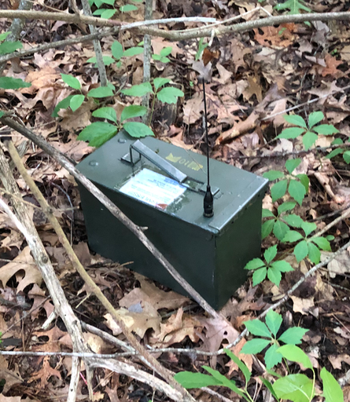
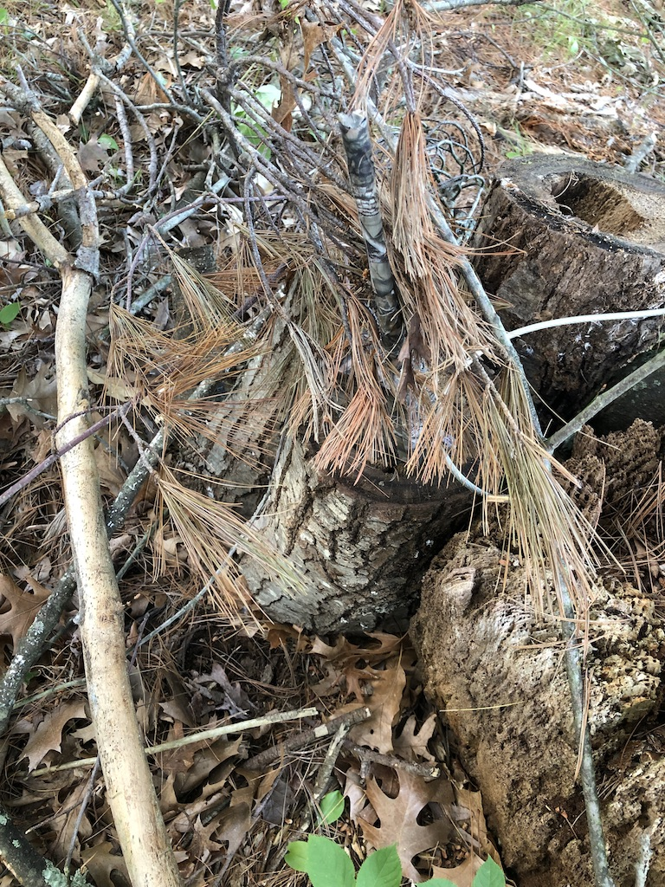
Fox Hunting
KB1OIQ’s Fox
KD1D’s Fox

Slide 26
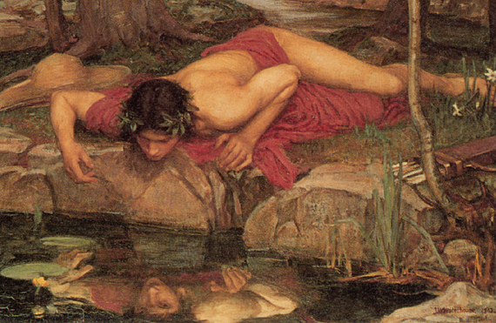
Logging
15 dupes
20 busted calls
One very special contact

Slide 27
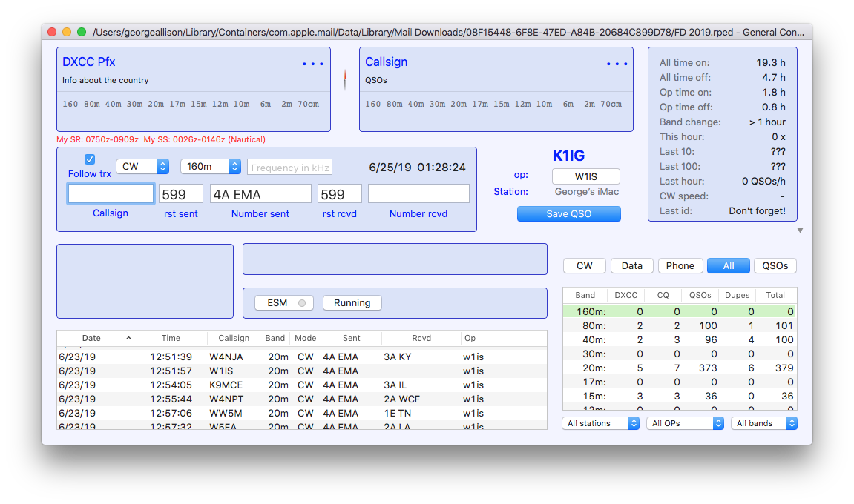
Logging

Slide 28
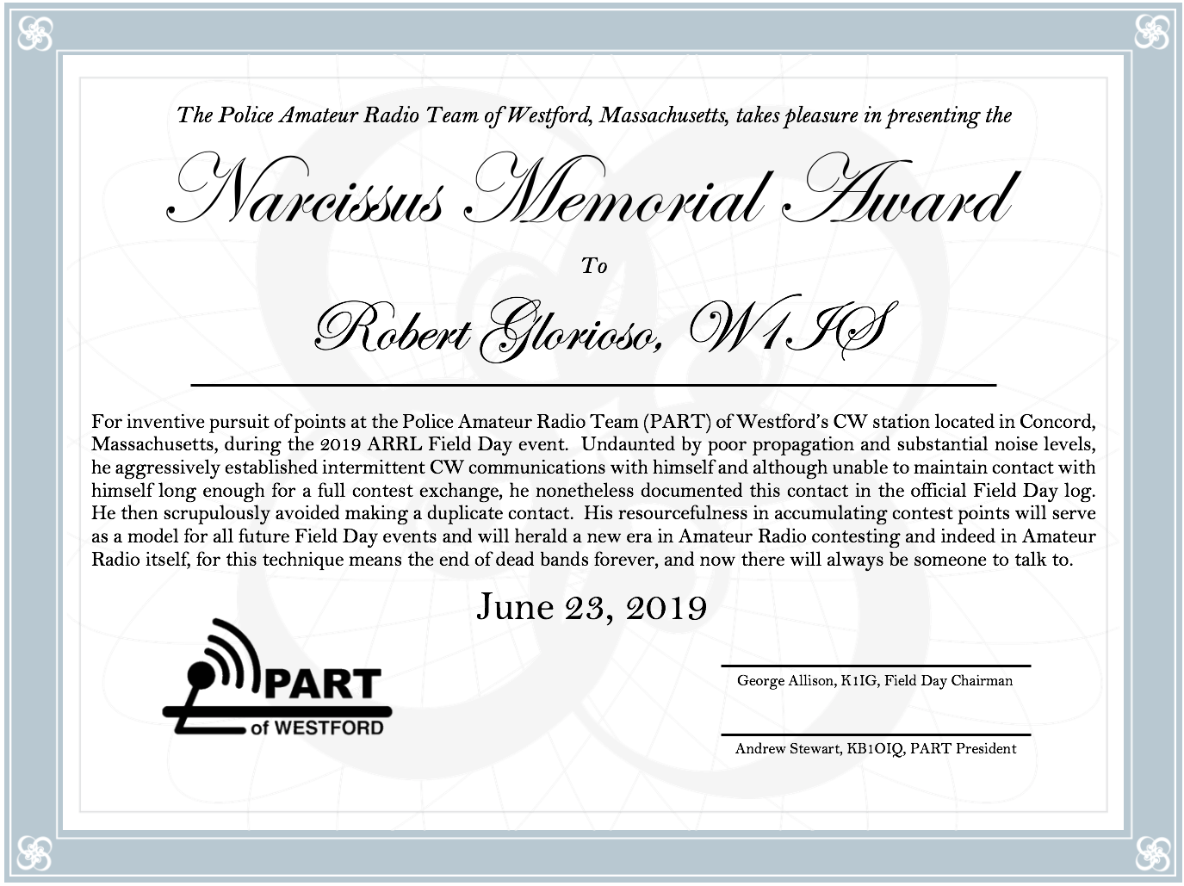
Logging

Slide 29
Total Points
Mode | QSOs | Multiplier | Total
CW | 602 | 2 | 1204
Digital | 120 | 2 | 240
Phone* | 574 | 1 | 574
 |  | Subtotal: | 2018
 | Power Multiplier: |  | x 2
 | Total QSO Points: |  | 4036
 | + Bonus Points: |  | 1710
* SSB, VHF, Sat, GOTA
Total Points = 5,746

Slide 30
Previous Scores
Year: | 2013* | 2014 | 2015 | 2016 | 2017 | 2018 | 2019
QSOs: | 723 | 1,669 | 932 | 1,319 | 1,307 | 1,536 | 1,296
Points: | 7,355 | 6,212 | 4,212 | 5,834 | 5,820 | 6,684 | 5,746
* QRP
Note: Fun is not measured by the score!

Slide 31
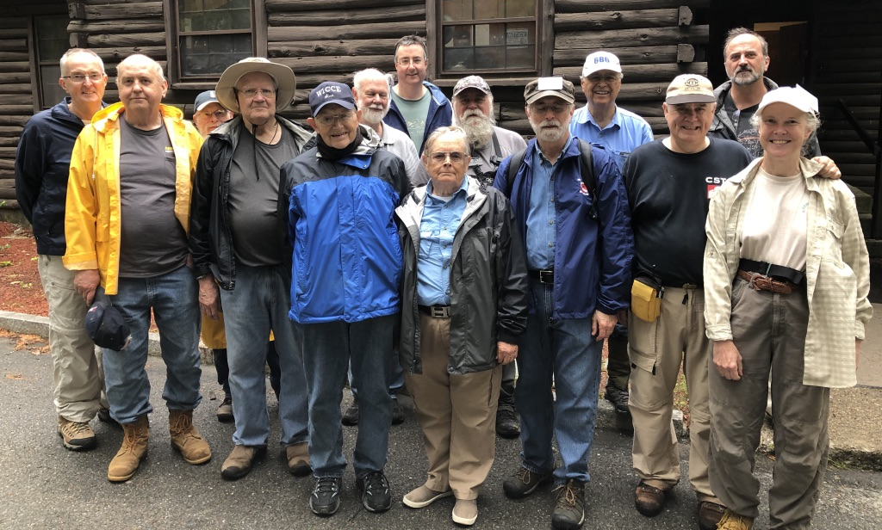
Things That Worked
*
Setup and teardown
Lots of volunteers
Storm response – Safety team plan
Off-center fed dipoles
FT-8
* A little more to do!

Slide 32
To-Do List
Before Field Day
After Field Day

Slide 33
Lessons Learned
Even at the bottom of the sunspot cycle we can make a lot of contacts – be ready when the bands open up.
Plan ahead for weather response actions
Pay attention to the safety briefing!
Things go smoother with lots of help.
We can always use more operators, especially CW & Digital

