Slide 1
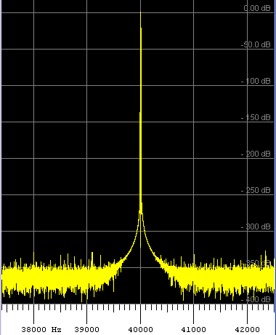
Precision Frequency Measurement,
Transceiver Calibration,
And The frequency measuring Test
George, K1IG
K1IG@arrl.net

Slide 2
Why Bother?
Be sure you’re on the right frequency - avoid an FCC QSL
DX spots are accurate
Does your net complain that you're off frequency?
Digital modes (PSK, WSPR…) require frequency accuracy
Drift with age
Know your rig and be able to optimize its performance
Participate in semi-annual ARRL Frequency Measuring Test
X
X
X
But my rig has a digital readout! It must be accurate!

Slide 3
ARRL Frequency Measuring Test
Began in 1931
Twice a year — April and November
Measure frequencies over the air
Goal is 1 Hz or better accuracy — measure and report to the nearest 0.01 Hz
100 - 130 participants worldwide

Slide 4
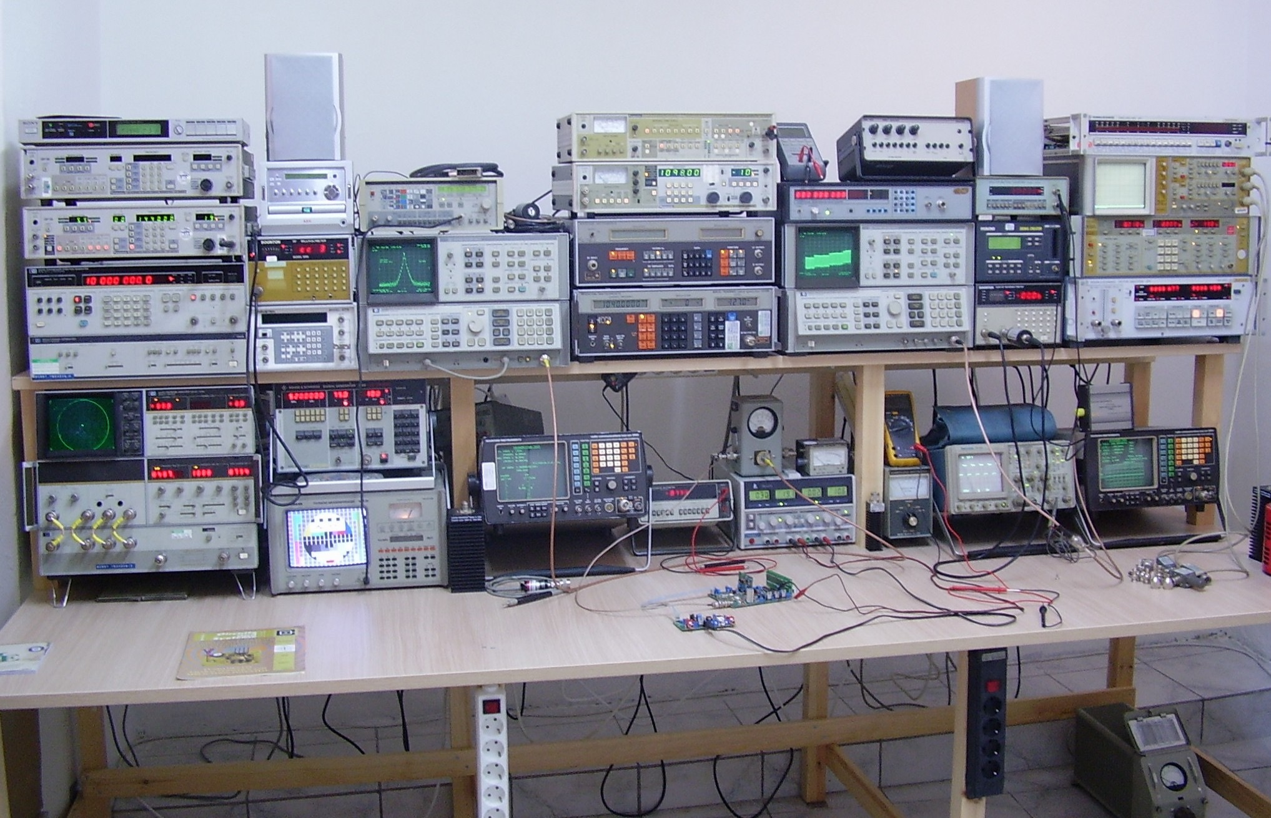
Minimum Setup?

Slide 5
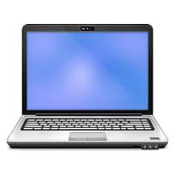
What you need
Windows
Mac
Linux
Rig
Audio Cable
Computer
These Three Things and Some Free Software
Get You Measuring Within 1 Hz

Slide 6
Three Step Process
Load software and set it up
Calibrate your computer
Calibrate your rig
Total Time = One Hour

Slide 7
Free Software
Windows
Spectrum Lab
http://www.qsl.net/dl4yhf/spectra1.html
Installation tutorial at:
http://www.ve2azx.net/technical/FMT/SpecLabInfo.pdf
Mac/Linux/Windows
Fldigi
http://www.w1hkj.com/Fldigi.html
Download, installation and help files on main webpage
WSPR
http://physics.princeton.edu/pulsar/K1JT/wspr.html
http://physics.princeton.edu/pulsar/K1JT/FMT_User.pdf

Slide 8
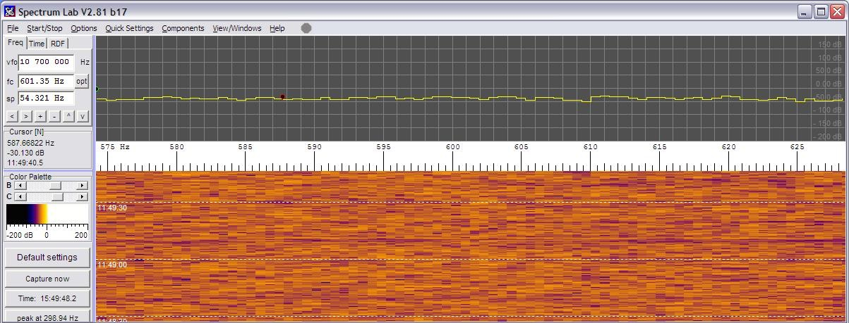
Spectrum Lab
Very versatile and accurate
Will run in Linux/Wine or Mac/Parallels at reduced capability

Slide 9
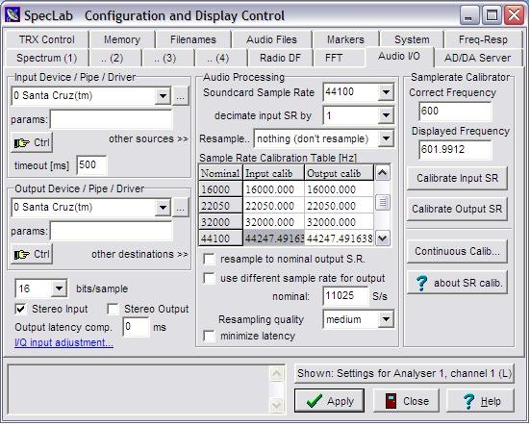
Spectrum Lab setup
Select sound card
Set Sample Rate to 44100
Hit Apply

Slide 10
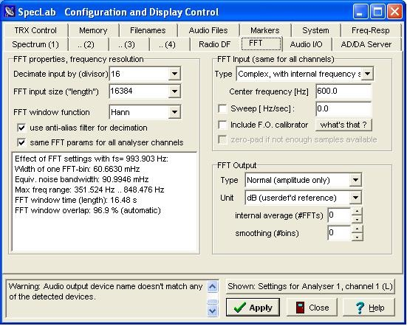
Spectrum Lab setup
Try these settings. If the display freezes, reduce them. Accuracy will suffer.

Slide 11
W W V

Slide 12
Computer Calibration
2-3 hour warm-up
Tune to any W W V in AM mode
Measure frequency during 600 Hz tone
Apply correction
Avoid sunrise/sunset times (WWV Doppler)
1
2
3
4

Slide 13
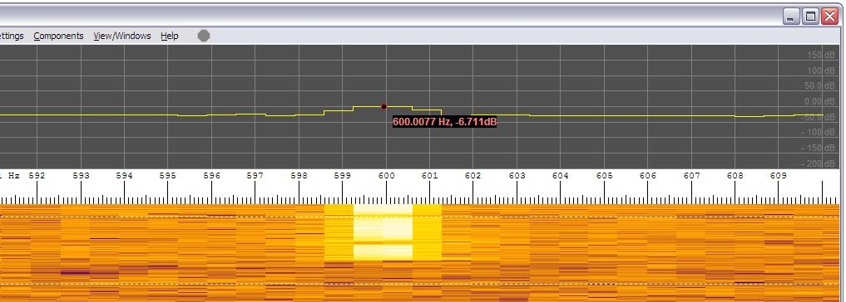
Computer Calibration
After calibration, we’re within 0.0023 Hz

Slide 14
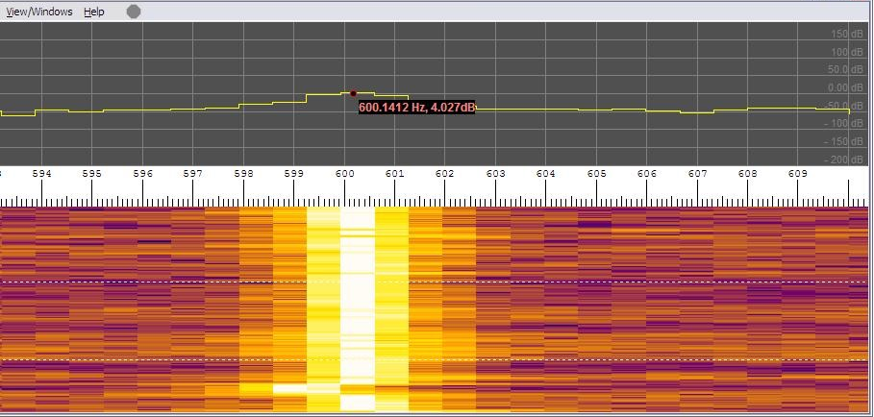
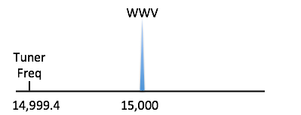
Rig Calibration
Set rig to USB
Tune to 15 MHz W W V
Re-tune to 14,999.400 KHz = W W V - 600 Hz
Measure the frequency of the carrier
Adjust your rig (if possible) to center the carrier at 600 Hz — consult manual

Slide 15
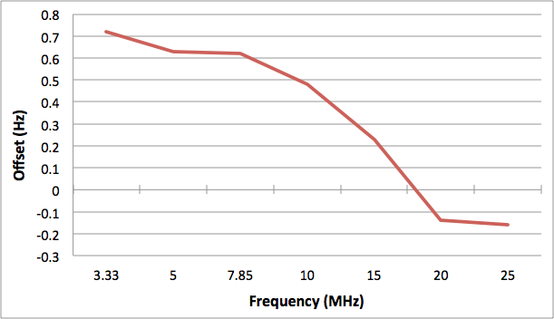
Rig Calibration
Measure all W W V and CHU frequencies (-600 Hz)
Make a correction chart based on WWV and CHU measurements

Slide 16
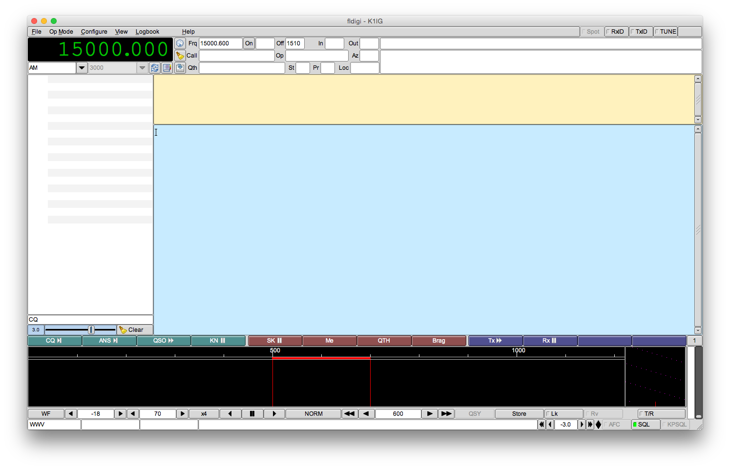
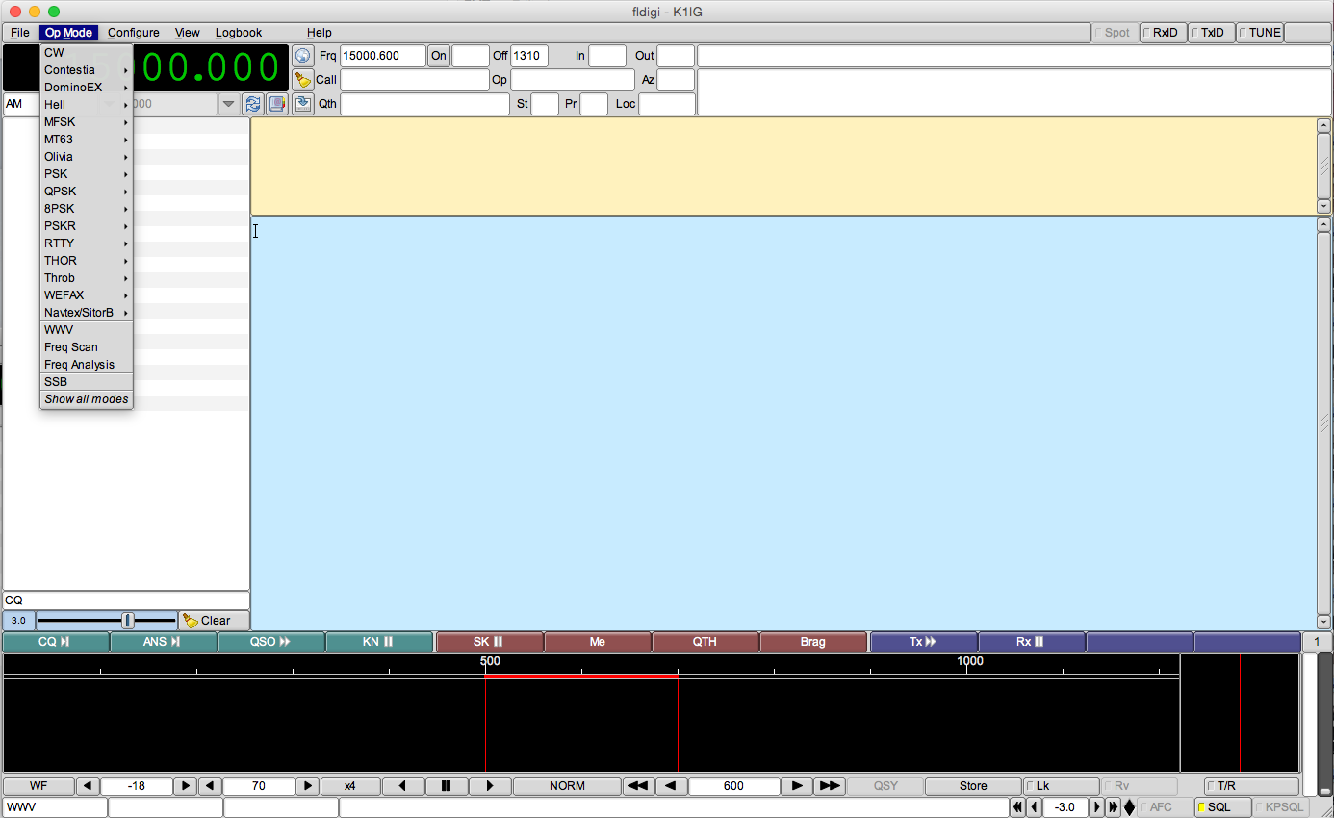
fldigi
Ref: FLDIGI Users Manual - Operating
Digiscope Display - W W V mode
Frequency Analyzer (v. 3.21)
Ref: FLDIGI Users Manual - Operating
Digiscope Display - W W V mode
Frequency Analyzer (v. 3.21)

Slide 17
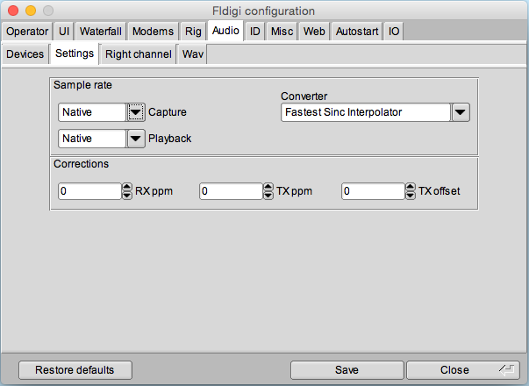
fldigi setup
Computer Calibration — Part I
Select Op Mode - W W V
Select View - Floating Scope
Select Configure - Sound Card
Make corrections here

Slide 18
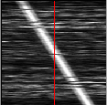
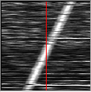
fldigi setup
Computer Calibration — Part II
Set Rig to AM — tune to any W W V
Apply “RX ppm” corrections to make the scope line vertical
-1000 ppm
+1000 ppm
Ref: FLDIGI Users Manual
Digiscope Display — W W V Mode

Slide 19
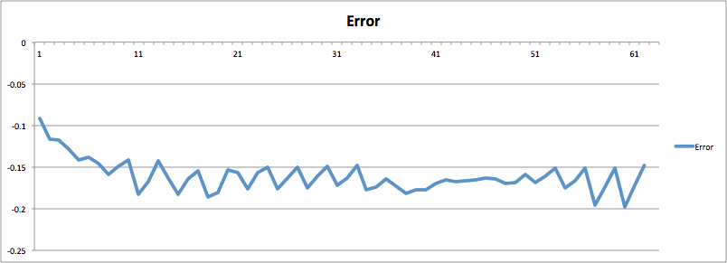
fldigi rig calibration
Set Rig to USB — tune to W W V - 600 Hz
Select Op Mode - Freq Analysis
Adjust rig so waterfall is exactly at 600 Hz
writing csv file
You’ll get a data file that you can import into a spreadsheet

Slide 20
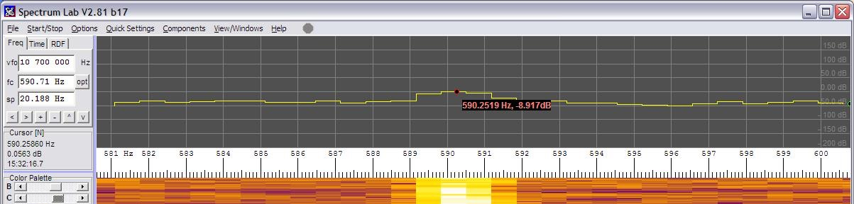
Frequency Measuring
Tune below frequency so sidetone is about 600 Hz
Offset error = +0.141 Hz
Tuner + Spectrum Lab ± Offset = Frequency
9,979,400 + 590.252 - 0.141 = 9,979,990.111 Hz

Slide 21
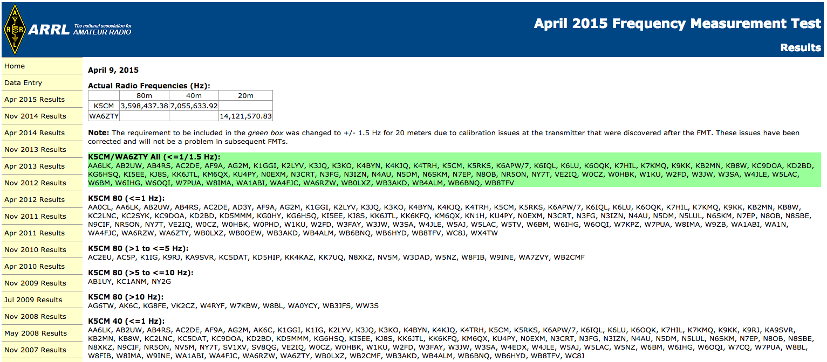
Frequency measuring test
Test announcement in QST and:
http://www.arrl.org/frequency-measuring-test
Data entry page and previous results are at:
http://www.b4h.net/fmt/
Test Format (three frequencies):
5 minute call-up
2 minute test (carrier or tone)
1 minute sign-off
Go to designated website and enter data to nearest .01 Hz
Perform calibrations before and after the test!
Actuals to nearest 0.01 Hz

Slide 22
techniques for
the truly serious
fanatical*
Record the test as a WAV file and play it back on other computers for analysis
Feed a 10 MHz GPSDO (GPS Disciplined Oscillator) signal into your receiver and computer for nanosecond accuracy
Warm up receiver for 48 hours in a temperature controlled blanket
* No guarantee of accuracy improvement

Slide 23
Rig calibration
EXACT!

