Slide 2


Slide 3
Field Day 2019
June 22-23
Setup: Friday, June 21
Concord Rod & Gun Club
  74 Strawberry Hill Rd, Concord, MA

Slide 4
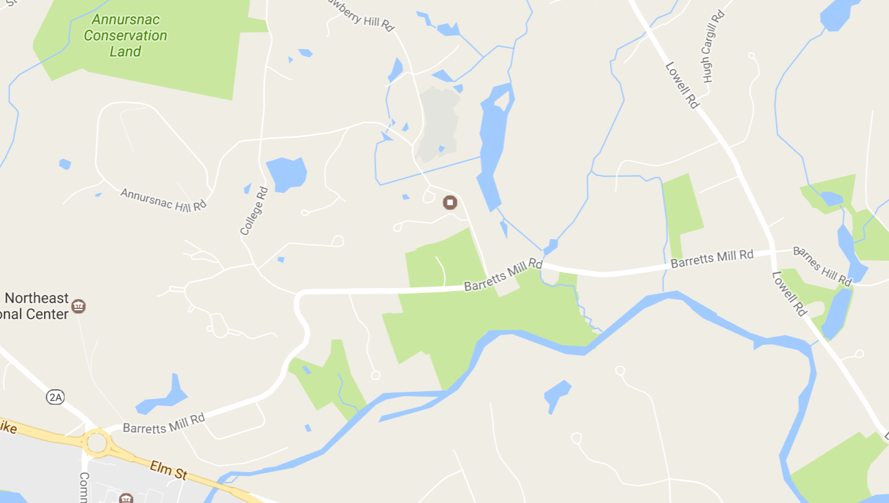
Concord Rod & Gun Club
74 Strawberry Hill Rd, Concord
Nine miles from Westford

Slide 5
Stations & Leads
Digital
  Rich, AB1HD
Satellite
  Bob, KB1SWZ
CW
  Bob, W1IS
VHF/10 Meters
  Allison, KB1GMX
Messaging
  George, K1IG
  John, WB2OSZ
Phone
  George, K1IG
GOTA
  Andy, KB1OIQ
Responsible for: rig, connectors, power supply, power distribution, antenna switch, headsets, office supplies, computer, logging SW, lighting, fire extinguisher, first aid kit, spare parts, control operators

Slide 6
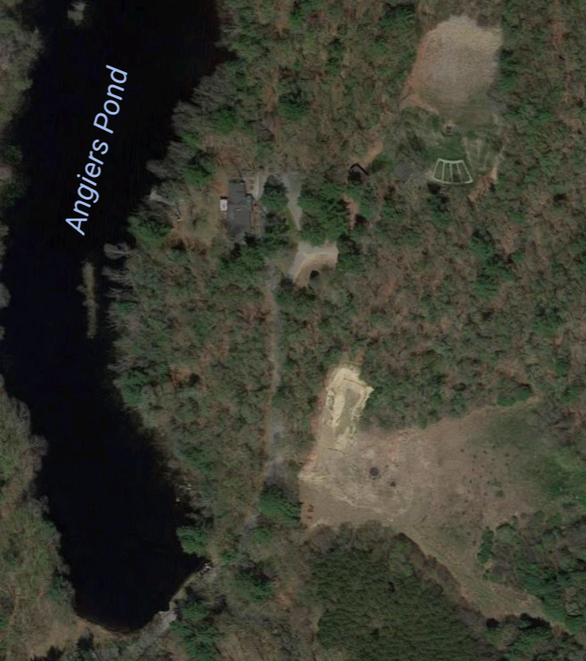
Site Plan
Antenna locations are approximate
CW
Digital
VHF/10
Satellite
GOTA
N
500 ft
Phone

Slide 7
Infrastructure Leads
HF Antennas
  Bob, W1IS
Food
  Charlie, W1ADL, Rick, W1RAG, Lela, KC1ACV
Media & PR
  Lela, KC1ACV
Safety
  Dale, KB1ZKD
Finance
  Alan, W1AHM
Signage
  Alan, W1AHM
Site Liaison
  Dale, KB1ZKD

Slide 8
Schedule
Friday 21 Saturday 22 Sunday 24
8:00 AM
Rig Setup & Check
11:00 AM
Training
Noon – Sunset 12:30 PM 12:00 PM
Antenna Setup Lunch Lunch
2:00 PM 2:00 PM
Operations Begin Operations End
6:00 PM Teardown
    Dinner

Slide 9
Weather
Friday: Showers before 9:00 AM
Weekend: Sunny, wind gusts, 55º – 80º
Cool nights – bring a jacket
Hydrate!
Don’t forget sunscreen!

Slide 10
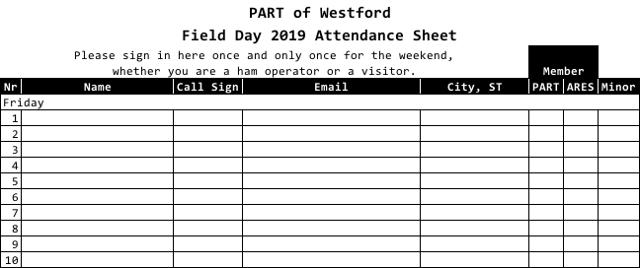
Attendance Sheet
Age <= 18
Needed:
Attendance Wranglers
EVERYBODY signs in
Once, and ONLY once!

Slide 11

Food!
Saturday Lunch
  Cold cut sandwiches
Guests?

Slide 12

Field Day Operations
Safety
446.025 simplex for site coordination
Visitors — We could see 50 or more
  — Wear your badge
  — Invite your neighbors
We’re selling Amateur Radio! Greet all the visitors and explain what you’re doing!

Slide 13
Bonus Points
Emergency Power (400 points)
Media Publicity
Satellite QSO
Alternate Power
W1AW Bulletin
Educational Activity
Youth Participation
Web Submission
Public Location
Public Info Table
Safety Officer
Site Visit by Elected Official
Site Visit by Agency Rep
Social Media
Message Handling
Message to Section Mgr.
GOTA Station

Most Items Are Worth Up To 100 Points

Slide 14
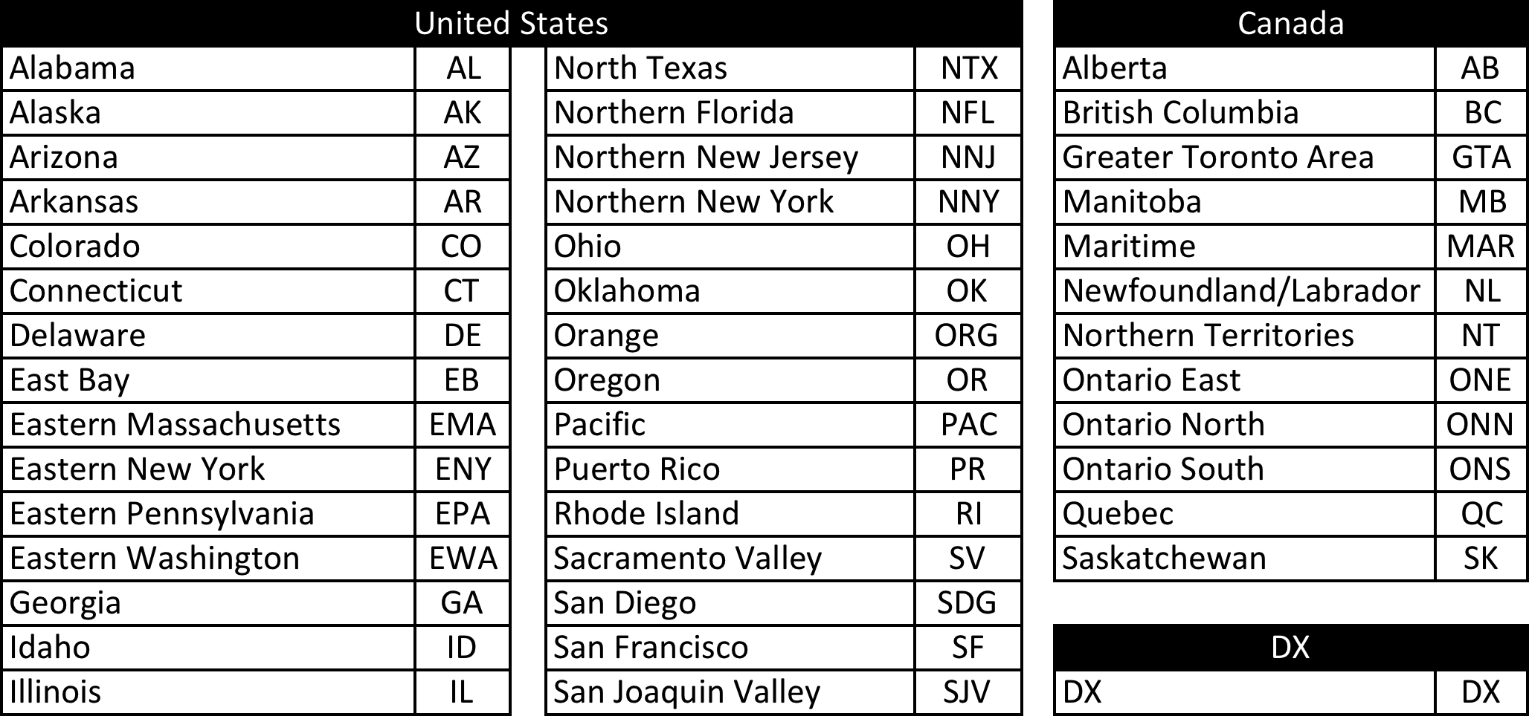
Contacts and Logging
Exchange: Class and ARRL section
We are: “4A EMA” or “4A Eastern Massachusetts”
Stations can be worked once per band - mode
Don’t say “Please copy”
Use correct Section abbreviations
Canada

Slide 15
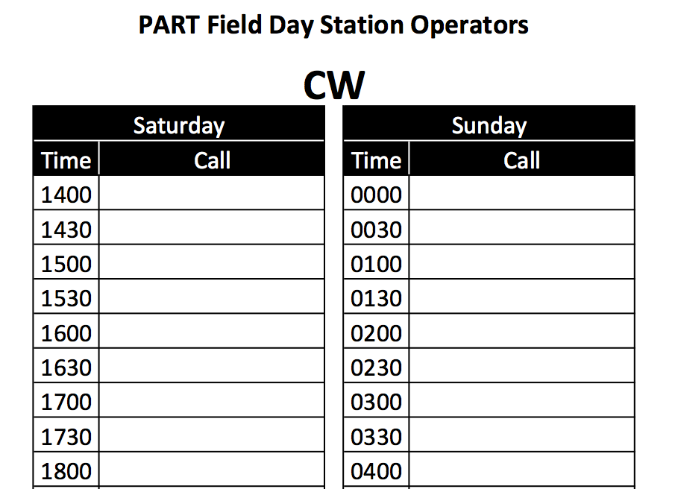
Operator Signup
Optional But, Those who sign up have
priority!

Slide 16
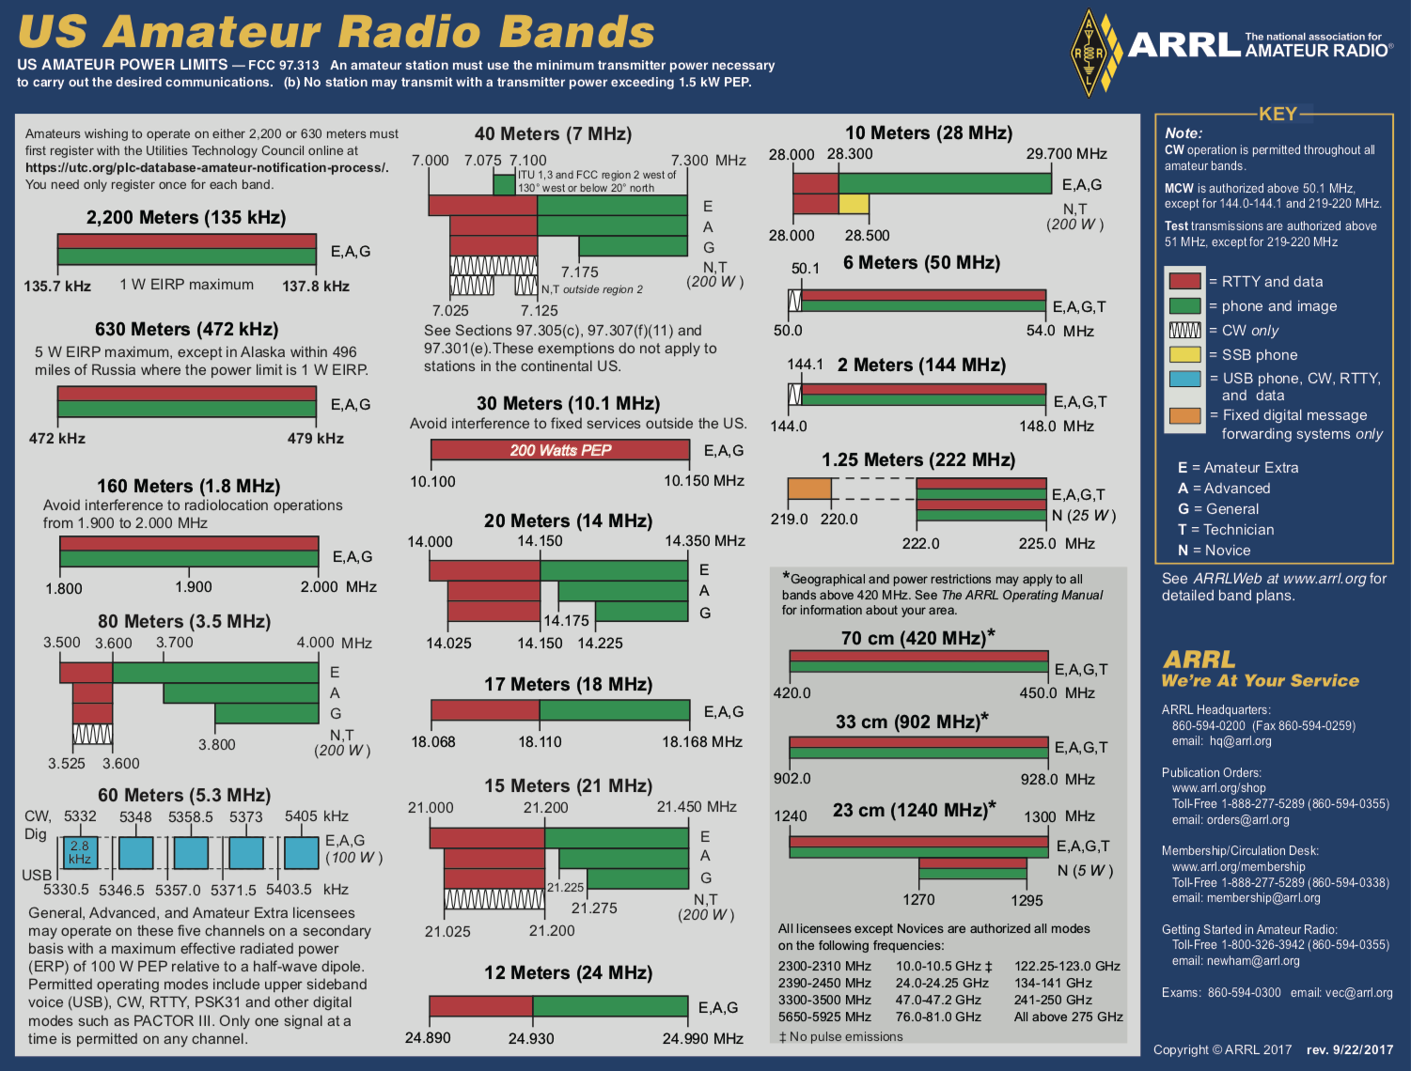
Field Day Operations
The Control Operator’s license class determines the band limits
Every station will have a copy of the band plan.

Slide 17
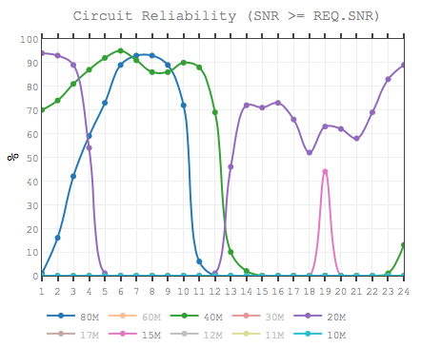
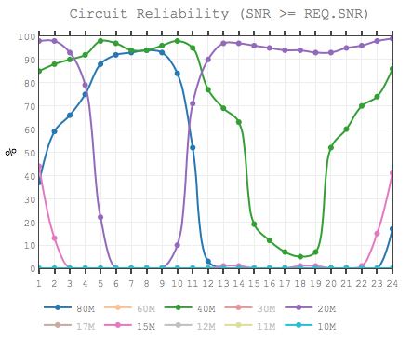
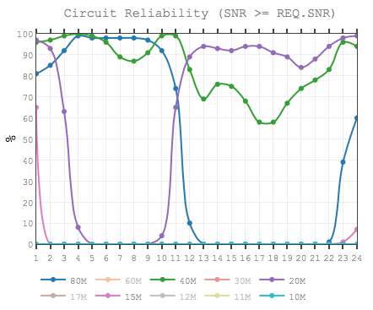
Propagation Forecast
West Coast
Central
South
Takeaways:
There’s a path open to somewhere all the time
Best bands: 80M, 40M, & 20M.
Midnight - morning operations are very productive
Try 80 meters! Look for openings on 10 meters!
Best for HI: 20M: Daytime, 40M: Night (Check DX spots)

Slide 18
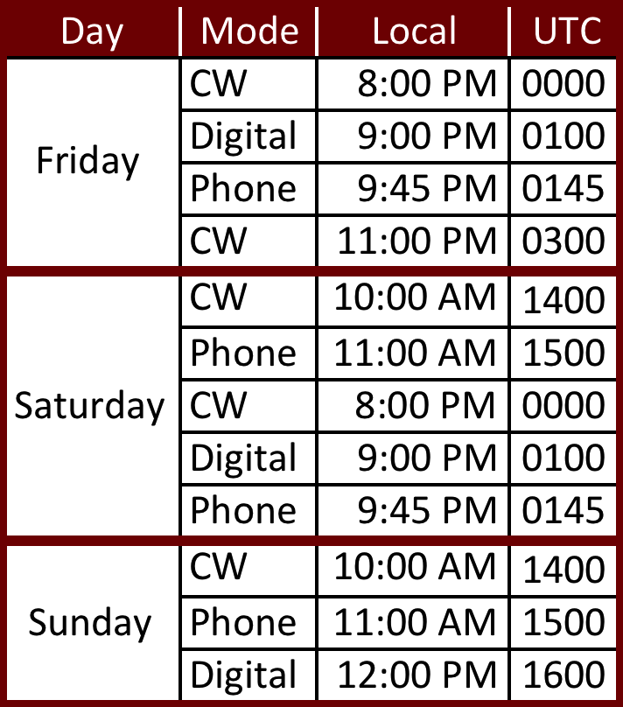
W1AW Field Day Bulletin
CW frequencies are 1.8025, 3.5815, 7.0475, 14.0475, and 18.0975 MHz.
Digital frequencies are 3597.5, 7.095, 14.095, and 18.1025 MHz. (PSK31 and MFSK16 are now included in the regular Digital runs.)
Phone frequencies are 1.855, 3.990, 7.290, 14.290, and 18.160 MHz.

Slide 19
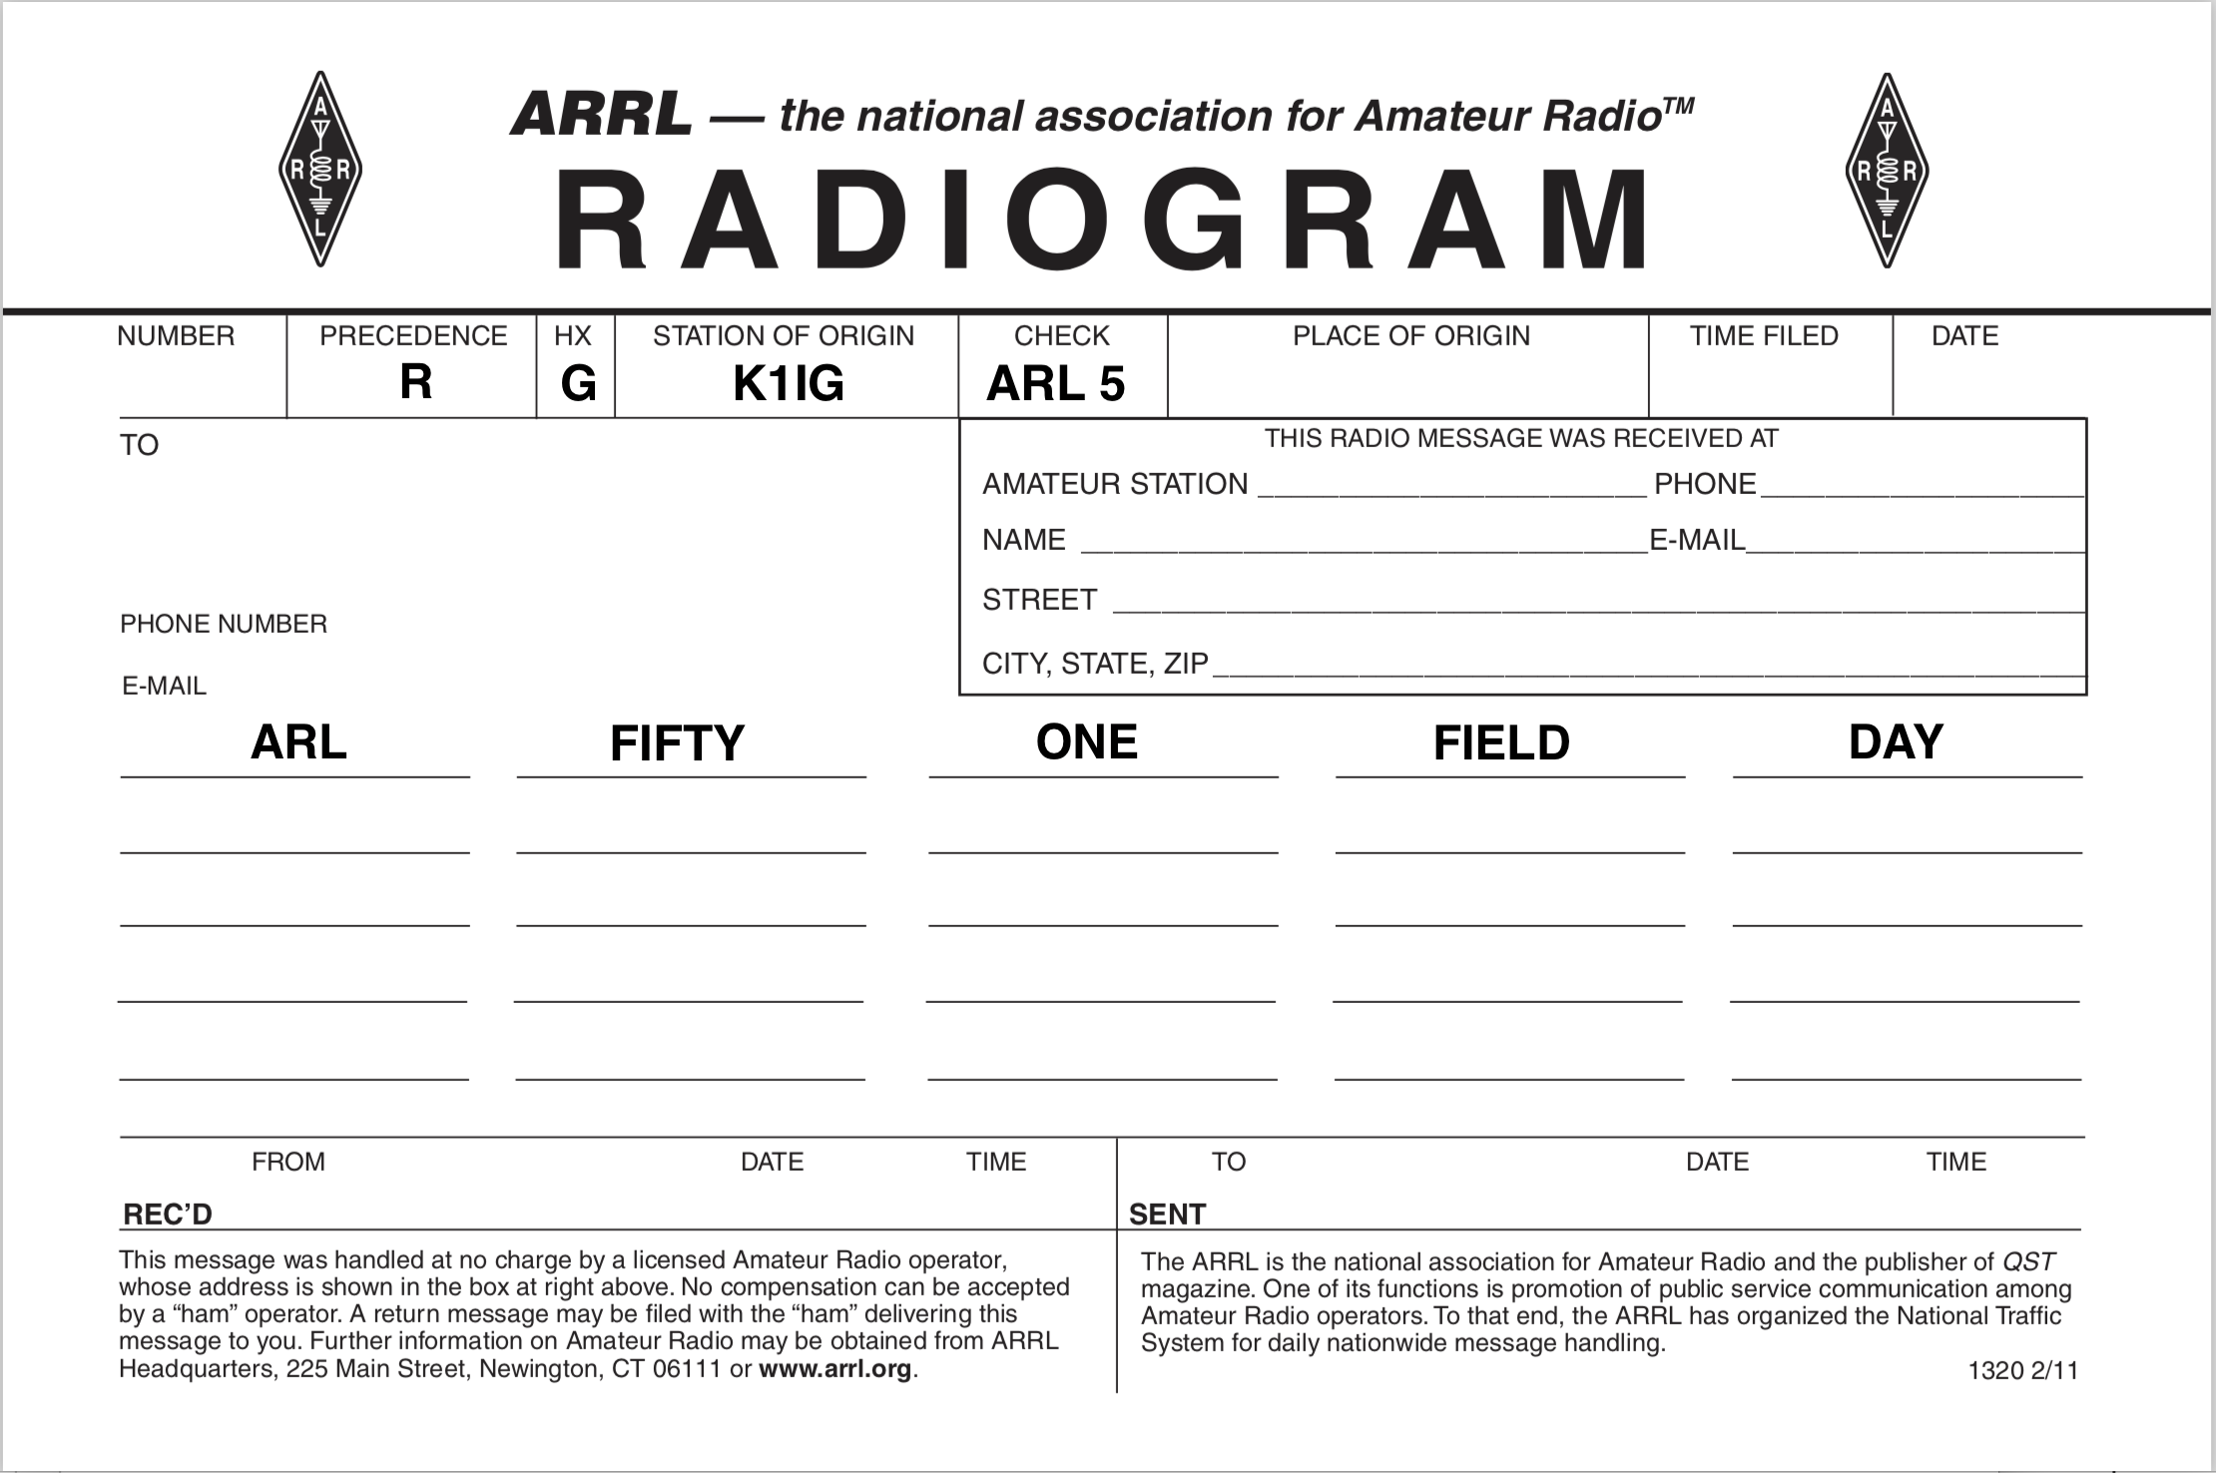
Messages
George, K1IG & John, WB2OSZ
One radiogram to Section Manager and 10 others
*
* “Greetings by Amateur Radio. This message is sent as a free public service by ham radio operators at Field Day. Am having a wonderful time.”

Slide 20
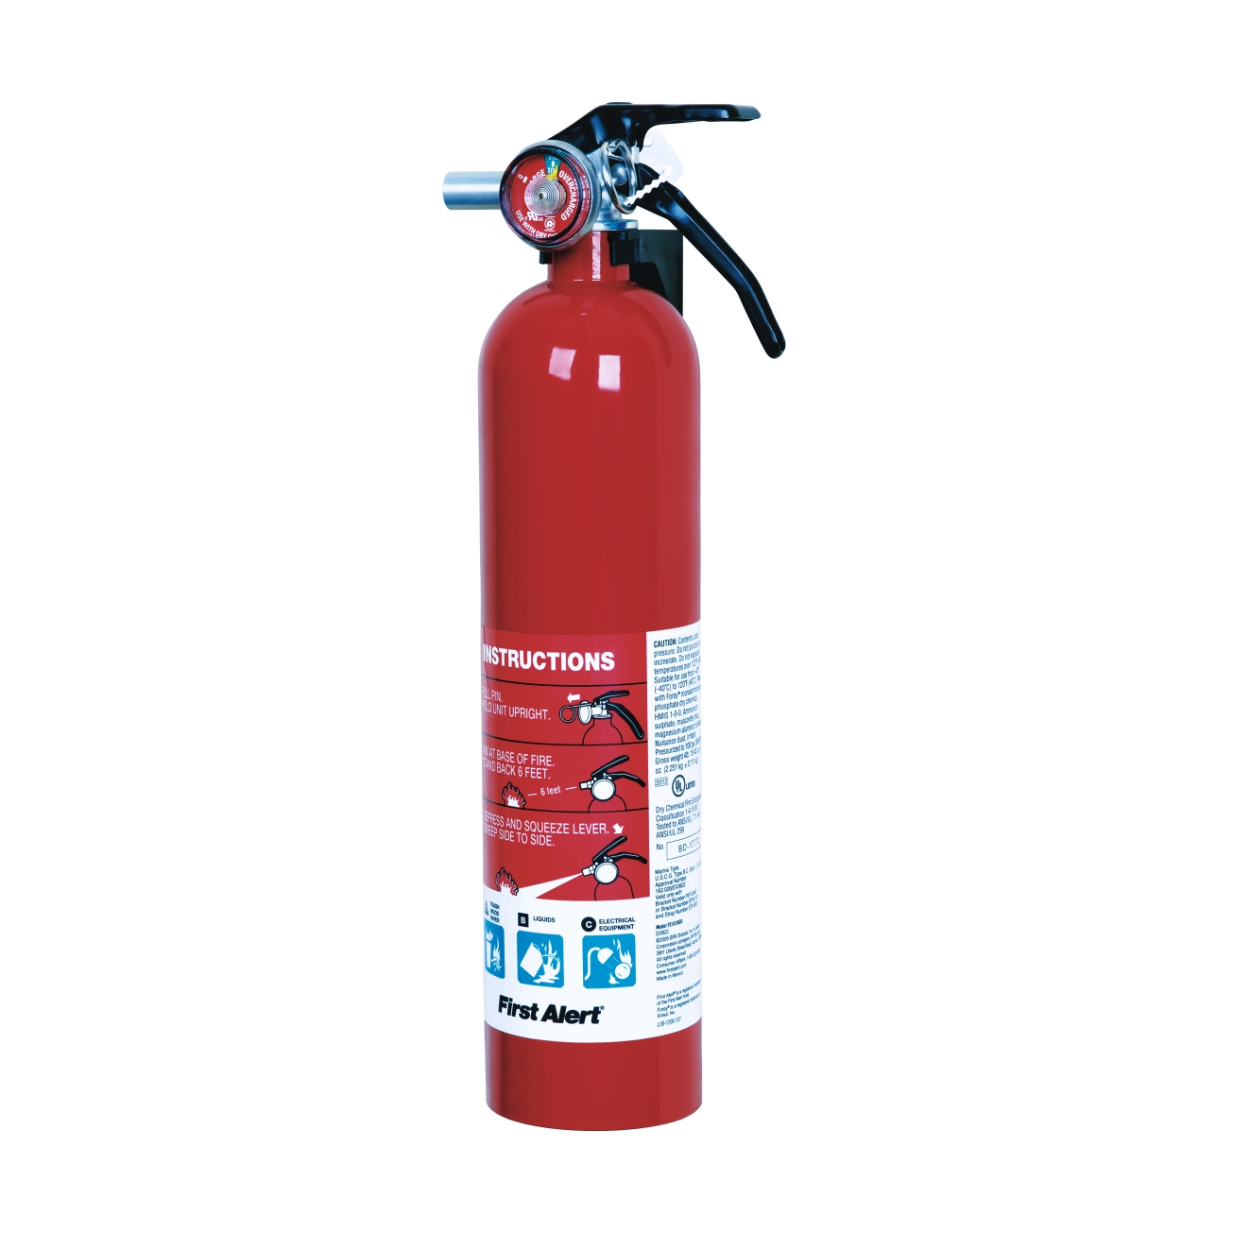

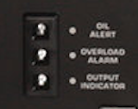
Generator Operations
Generators can run about six hours on one fill-up (longer with aux tank).
Recommend refueling every four hours — “Graceful Shutdown”
Generators CANNOT be refueled while running
If red light comes on, generator shuts down!
OIL ALERT
OVERLOAD ALARM
OUTPUT INDICATOR
Status Lights

Slide 21
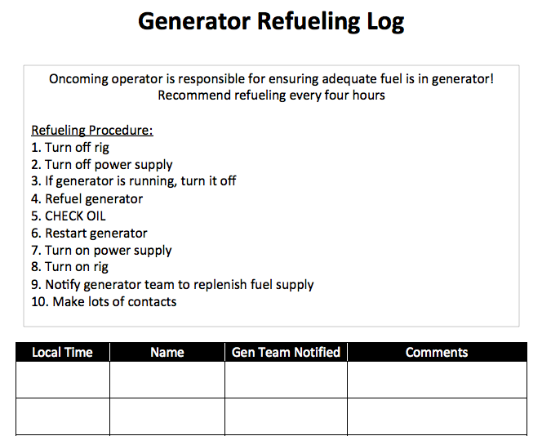
Generator Operations
If rig has battery backup you can continue operations — just turn off the power supply while refueling

Slide 22
Antennae
Bob, W1IS

Slide 23
Materials to Launch Antennae
2,000 ft Rope
1300 ft RG-8X
Bow and Arrows
Air Guns
Twine
Safety Tape to mark ends in the woods & trip zones
At least 15 energetic hams to launch & tear- down!

Slide 24
SSB, GOTA & Digital
SSB
  600 ft rope, ~400 ft RG-8X
  Multi-Band OCF designed & built by KC1DSQ
  2 element tri-band beam 20, 15 & 10 M, built by Allison, KB1GMX
  2 element 40 M beam designed by W1IS
  Receiving loop – 100 ft wire, vertical loop, 9:1 balun
  Safety tape
GOTA – G5RV (200 ft rope, 100 ft RG-8X)
Digital
  Multi-Band OCF designed by KC1DSQ & built by W1IS
  300 ft rope, 100 ft RG-8X
  Safety Tape

Slide 25
CW & VHF/10 Stations
CW
600 ft rope, ~ 400 ft RG-8X
G5RV
2 element 40M Beam designed by W1IS
2 element tri-band beam, 20, 15, & 10 M built by W1IS
Receiving loop - 100ft wire, vertical loop, 9:1 balun
10M & VHF
300 ft rope, ~300 ft RG-8X
6M loop suspended from tree
2M small beam up ~ 20 ft
2M vertical on pole for FM
10M half wave vertical suspended from tree

Slide 26
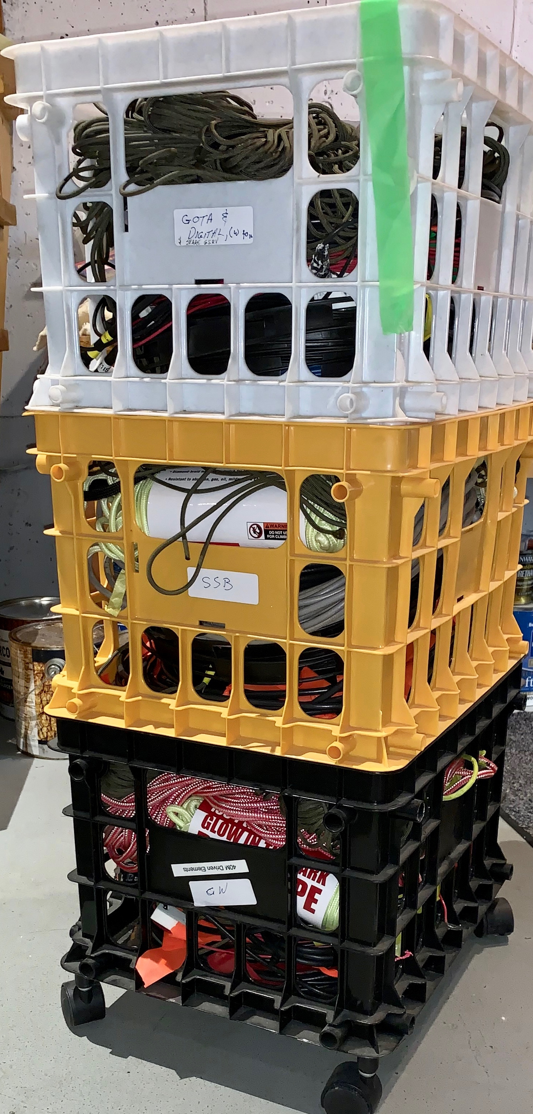
Guidelines for Set-Up
Milk crates: SSB, CW, GOTA/Digital
10M & VHF: Allison’s truck
Crates top to bottom: ropes - antenna - coax, repeat.
Antennas, coax and most ropes labeled. Default L = 100 ft.
2 people to un-roll and roll-up wire beams, Please
Put up multi-band antennas first, OCFs & G5RVs
Beams point WEST to cover the whole country.

Slide 27
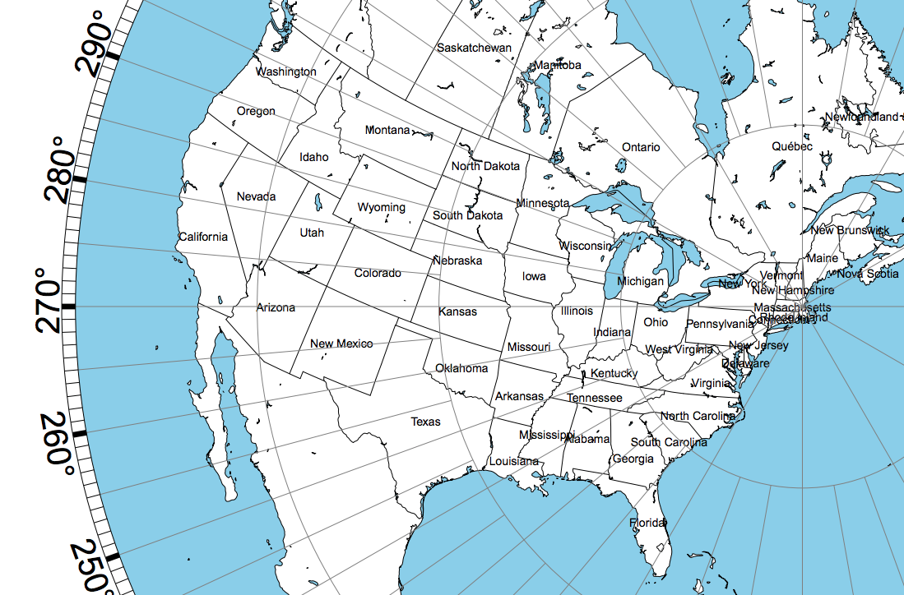
Aiming the Beams
– West to Dallas
240º
230º

Slide 28
Aiming the Beams
– West to Dallas
City | Great Circle Heading from MA | Direction
Seattle | 312 | WNW
San Francisco | 296 | WNW
Buffalo | 294 | WNW
Denver | 291 | WNW
Chicago | 289 | WNW
San Diego | 286 | WNW
Phoenix | 284 | WNW
Oklahoma City | 275 | W
Dallas | 269 | W
New Orleans | 257 | WSW
Atlanta | 249 | WSW
Miami | 222 | SW
3 dB Beam Width 20 M beam
70 Degrees
3dB Beam Width 40 M beam
99 Degrees
Miami Heading – Seattle
90 degrees

Slide 29
Guidelines for Tear-Down
Rolling up wires & ropes neatly will save time next year.
2 people to roll up beams – one spreader at a time.
  Start at one end & roll towards center
  Roll up other end rolling in the same direction
  Watch the ends – they tend to slip off when rolling up
Return cables & ropes to their owners
Names/Calls on coax really helps, otherwise it’s probably W1IS’s.

Slide 30
Thank You & Let’s Have Fun This Weekend

Slide 31
Field Day Stations

Slide 32
Information Packets
Each station will be given a packet with:
  Station Identifier Sign
  Band Plan
  ARRL Section List
  Generator Log
  Exchange Information Sign
  Operator Sign-Up Sheet
  ARRL Bulletin Schedule

Slide 33
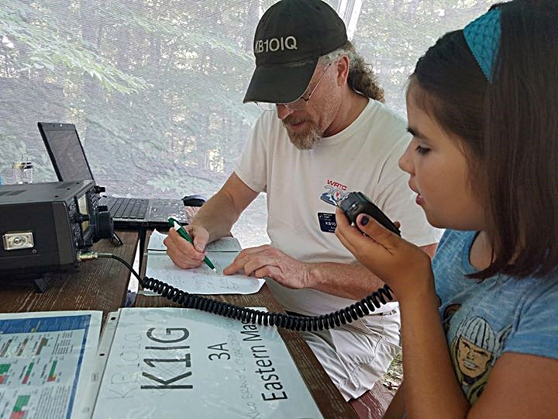
Get On The Air
Andy, KB1OIQ

Slide 34
Get On The Air (GOTA)
Station Lead: Andy, KB1OIQ
Rig: IC-7300 (Provided by Andy KB1OIQ)
Antenna: G5RV (Provided by Bob W1IS)
Power: 100 Ahr battery, recharged via 130W solar panel & generator
Tent: Provided by Andy, KB1OIQ
Logging Computer: Provided by Andy (KB1OIQ)

Slide 35
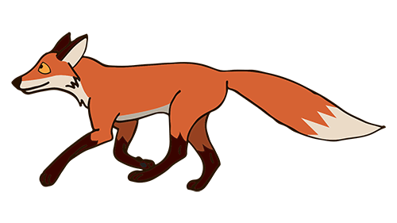
GOTA Station Rules
The GOTA station may be operated by any person licensed since the previous year’s Field Day, regardless of license class. It may also be operated by a generally inactive licensee. Non-licensed persons may participate under the direct supervision of an appropriate control operator.
When GOTA operators complete 20 QSOs, they receive 20 bonus points. Upon reaching an additional 20 QSOs the same operator receives a second 20 bonus points, up to a maximum of 100 bonus points per GOTA operator.
Full-time coach doubles bonus points

Slide 36
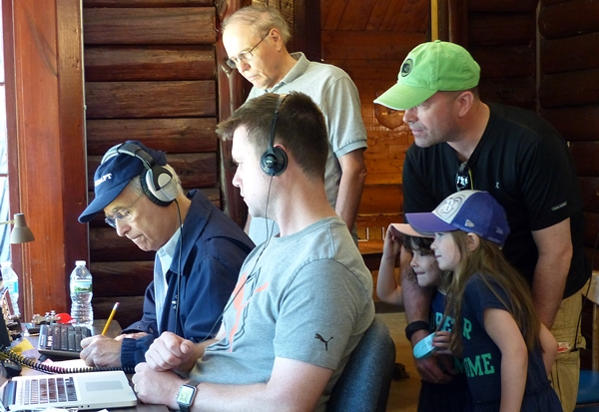
CW Station
Bob, W1IS

Slide 37
Field Day Preparation

Slide 38
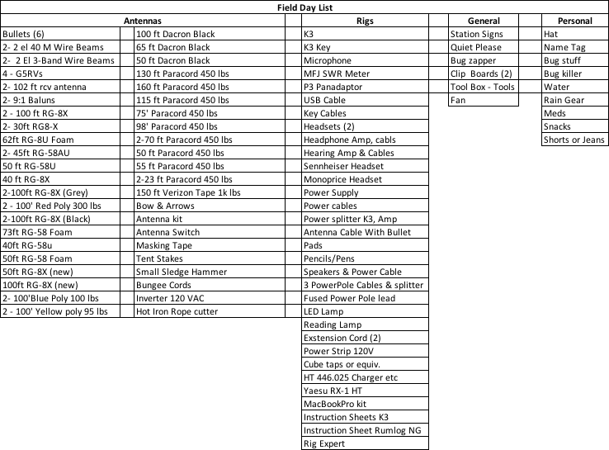
Field Day Preparation

Slide 39
Elecraft K3
6
X
X
X
X
X
X
X
X
X
5
7
X
12
X
X
8
9
X
4
X
2
10
11
1
X
X
3
X

Slide 40
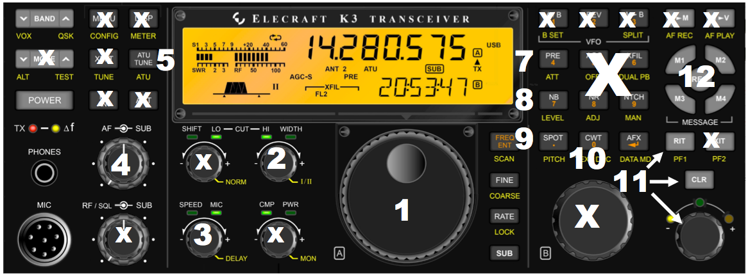
K3 Controls for CW at FD
Main Tuning
Width Control: Don’t Push - changes filter type – leave in Band-Pass
Speed Control: Internal Keyer Speed Adjustment
Volume control
ATU: Push & Hold to turn on tuner – Momentary Push to Tune
Band Change Buttons
Pre-ATT: Push for Pre-Amp, Push & Hold for Attenuator (ATT helps with QRM, QRN especially on 80 & 40 M)
NB: Push for Noise Blanker, Hold to set Blanker Level w/VFO B knob
Spot: Zero beats signal, very handy
CWT: CWT turns on tuning meter – tune to center to zero beat
RIT Control: Receiver offset tuning (Use when running a perch)
6

Slide 41
12 – K3 Memory Keyer
M1 sends K1IG
M2 sends 4A EMA
M3 sends CQ FD K1IG
Same & more also on Keyboard / RumLogNG
Please don’t touch the “Rec” button!
Note that pro-signs like K and AR are rarely used in the heat of “the battle” unless you are dealing with a new operator at the other end. Then do what you can to make it easier for them.

Slide 42
X
Don’t touch any button with an X unless you are sure what it does. FD is not the time to experiment.
If you accidentally hit an X button, please contact: George - K1IG or Bob - W1IS.
If all else fails – READ THE MANUAL!
X
X
X
X
X
X
X
X
X
X
X
X
X
X
X
X
X
X

Slide 43
Don’t Be Overwhelmed!
Several here to help
  We will walk you through a few QSOs
You can do QSOs with keyer, straight key or keyboard.
Most importantly –
HAVE FUN!

Slide 44
RumLogNG
Contest Logger
W1IS, K1IG

Slide 45
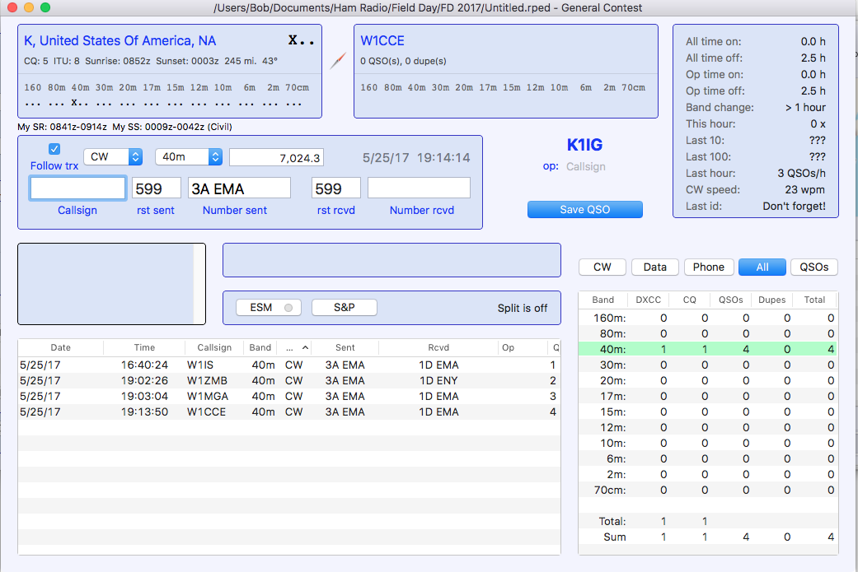
Logging Window
Mode & Band
Exchange Window
Put your Call here before you operate
Stats
Call Window
Current
Band
Similar Calls
SPC – Super Check
Partial
Go/No-Go Window

Slide 46
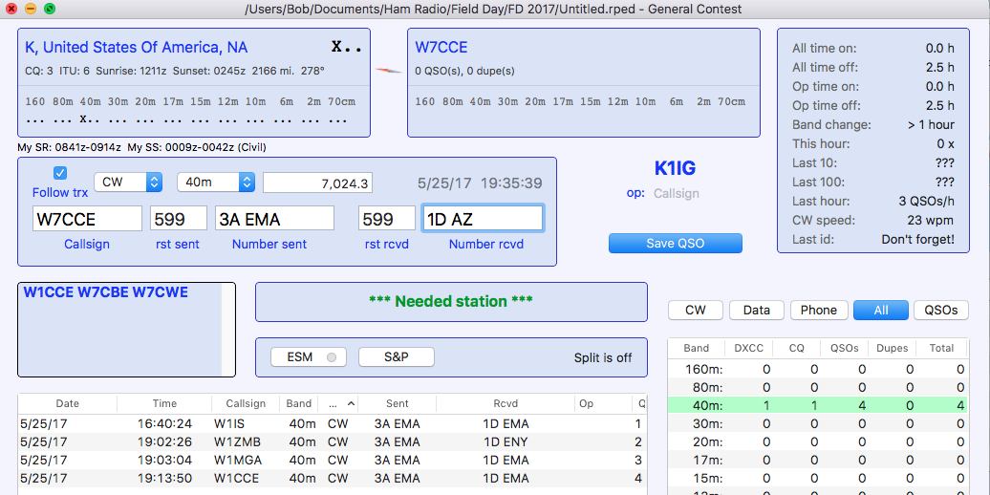
Good S&P Contact
Enter Call in Call Window
“Space“ to go to Exchange Window – Green means not a Dupe
Enter Exchange Received in Exchange Window
F6 to send our Exchange or send it by hand
“Return” to Log QSO
Call Window
Good Contact
QSO
Count

Slide 47
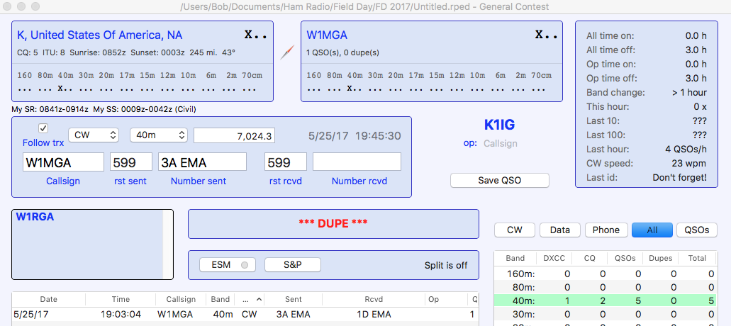
“DUPE”
Identify Dupe in RED
If in “Run,” Complete QSO – SW will remove it before submittal
If in “S&P” quickly move on
DUPE!!!

Slide 48
Send Canned Messages
Function Keys
F1 – CQ FD K1IG
F2 - QRZ
F3 – (Empty for technical reasons)
F4 - K1IG
F5 – Sends Call entered in Call Window
F6 – Sends 4A EMA
F7 - TU
F8 - AGN

Slide 49

Hints
Enter Your Call in the “Op” window below K1IG
CRITICAL - Always Check Band & Mode when Starting and Changing Bands
If RUMlogNG doesn’t show same frequency as the rig, follow steps below
  Transceiver > Reset CAT #1
  If that doesn’t Exit RUMlogNG – RUMLog>Exit Rumped or ⌘Q
  Restart RUMlogNG – Click “Book Icon” on bottom screen menu
  If that doesn’t work continue.
  Restart Computer – Click Apple Icon in upper left >Restart or Hold on-off button for 10 seconds.
  If that doesn’t work – SEEK HELP from K1IG or W1IS

Slide 50
In Case of Difficulty
To Edit a QSO – Double click, Edit in new window and SAVE
Incorrect Band or Frequency – Menu at top of screen > Transceiver> Reset CAT #1
Accidentally get into RST or Number Sent Windows – Fix them by hand and Tab to Number Received and complete entry
Delete QSO – Menu on top > QSO>Delete QSO

Slide 51
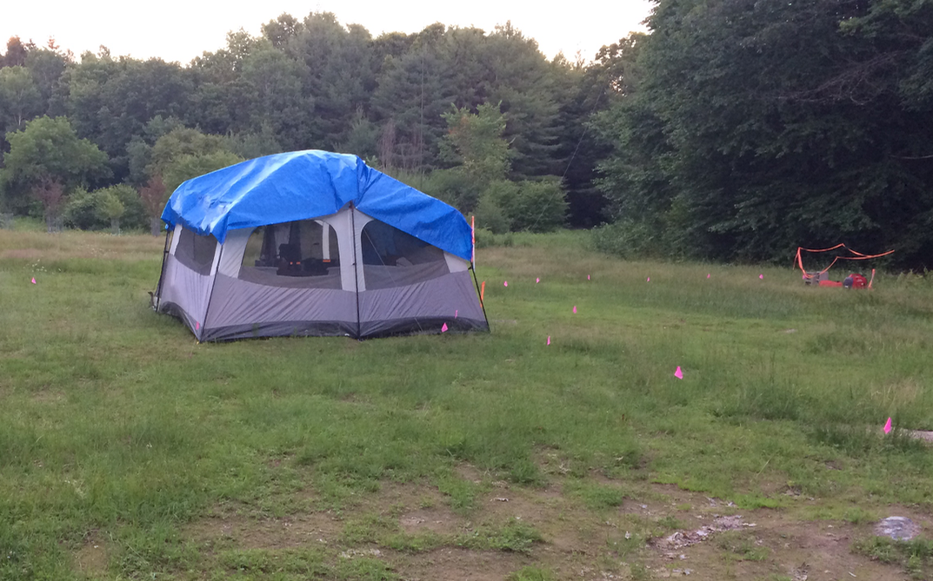
Phone Station
George, K1IG

Slide 52
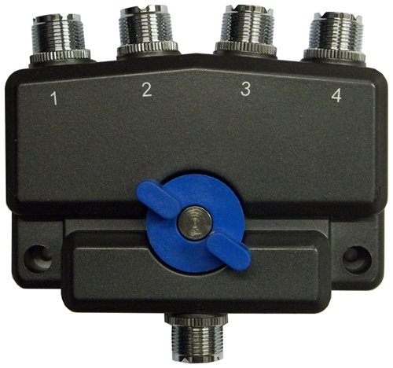
Elecraft K3
Battery backup (35 Ah)
Headsets & mic / speakers
PTT: pistol grip/footswitch
3 antennas – manual switching
80
40
20 - 10

Slide 53
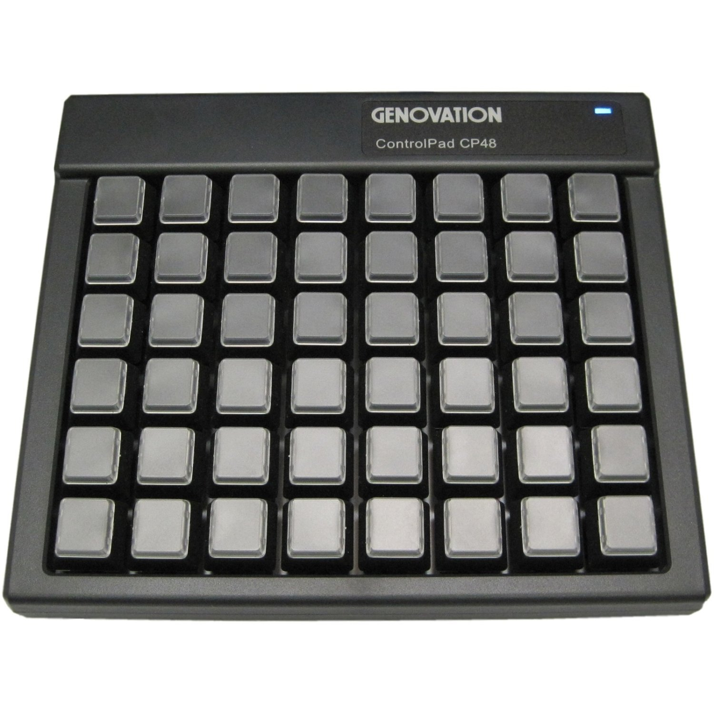
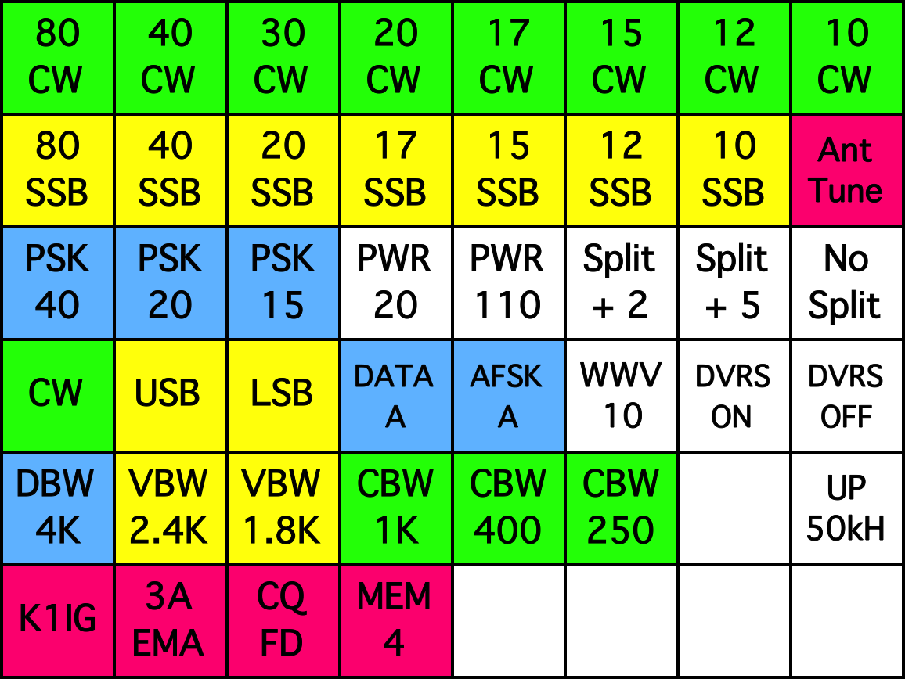
Keypad Control
Single button selects band, mode, frequency (bottom of Extra class phone band), sets filter and bandwidth
For phone operations, just use the yellow buttons (mostly)
Switch antenna manually – then ANT TUNE button!!!

Slide 54
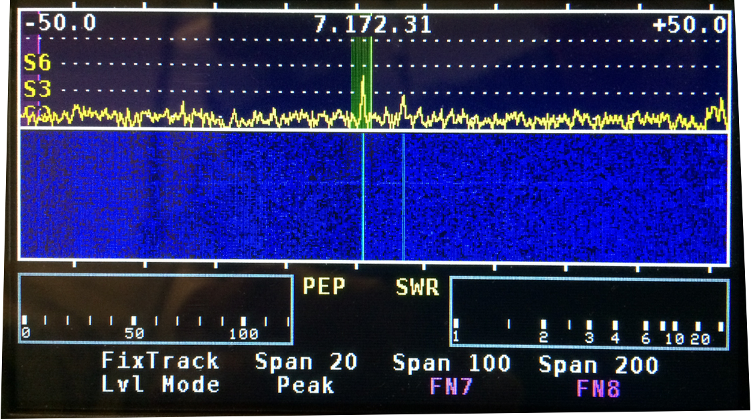
Panadapter - Receive

Slide 55
Panadapter - Transmit

Slide 56
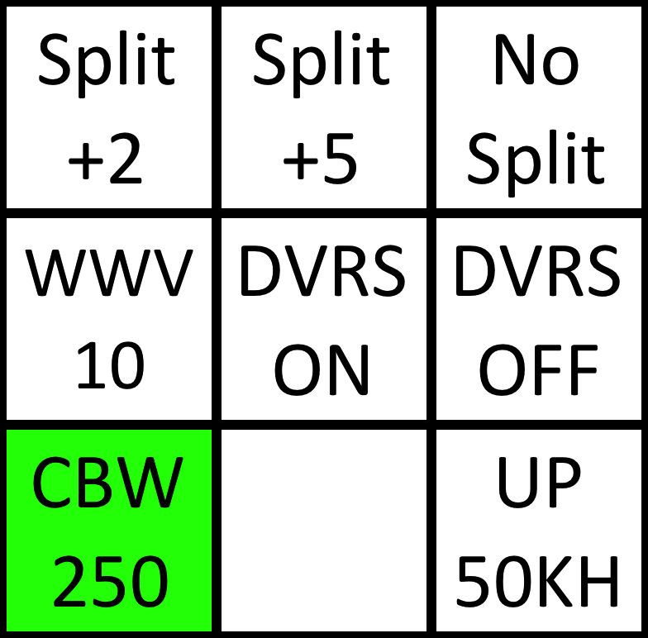
K3 Diversity Reception
The K3 has two receivers — in diversity mode, each can be on a different receive antenna
The two receivers are on the same frequency and both are controlled by the same VFO
Main rcvr: left ear; sub rcvr: right ear
K3 Button
XMIT/
RCV
Keypad
RCV Only
HOLD SUB button to turn diversity on and off. VFO decimal point will flash when diversity is on. TAP the button to turn sub receiver off.

Slide 57
Digital Station
Rich, AB1HD

Slide 58
ICOM 7300 With FT8
Turn on the external 12 volt DC power supply
Press the Power button on the IC 7300 (Upper Left)
Press the MENU button on the bottom left
Touch Load Settings
Select either 20M or 40M FT8 (touch Screen)
Turn power off wait 1 second and turn it back on
The main display should now show your operating frequency, e.g., 14.074 MHz for 20 meters and USB-D

Slide 59
ICOM 7300 With FT8
Press the multipurpose knob (Upper right side of panel)
Make sure power is set to 25% or less. Compression is automatically disabled in digital modes.
Set monitor to off or set the volume level you like.
Start WSJT-X software on the laptop
Make lots of contacts…

Slide 60
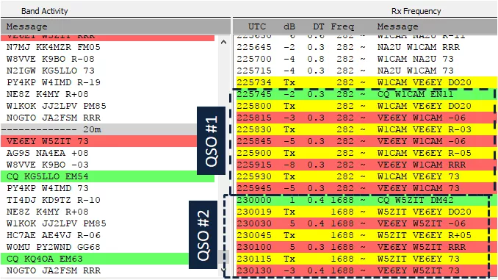
WSJT-X Using FT8

Slide 61
VHF/10 Station
Allison, KB1GMX

Slide 62
VHF/10M Station
What’s new this year?
Less is still more.
We add 10M for interest!

Slide 63
VHF/10M Antennas
VHF 6M Rectangle loop, really high! An easy antenna to make!
VHF 2M Square
10M vertical end fed half wave. It’s an antenna your can build easily.
2m horizontal and vertical for 2M on mast strapped to shed.

Slide 64
VHF Radio
Easy radio to use, things do as marked, no menus.
Bob, KB1SWZ

Slide 65
Tentec Eagle

Slide 66
Tentec Eagle
This will be the 10M 100W radio for phone
The Quick start card will be on hand for reference.
Easy radio to use, no menus.

Slide 67
Tentec Eagle

Slide 68
Tentec Eagle
6M
  CW only from 50.000 to 50.100
  SSB from 50.100 to 50.275
  Data above 50.250
  SSB DX window is 50.100 to 50.125
  CW is allowed and does occur anywhere!
2M
  CW only from 144.000, 144.100
  SSB from 144.100 to 144.300
  From 144.100 to 144.150 data is often used there
  CW is used everywhere in the band!

Slide 69
Operation
Why 10M?
10M
  - Band is 28 to 29.700 Mhz
  - Tech section is 28 to 28.5 Mhz
  - BANDPLAN
    - 28 to 28.3 CW, Data, Beacons
    - 28.300 to 28.500 tech SSB phone
    - above 29 Mhz is repeaters and FM
The tech phone section is also home to 28.4 MHz the calling frequency and the most active SSB portion of the band.

Slide 70
Power
If the sun shines 150W of solar power plus battery
The back up to that is the battery 60AH and genset.
Note on genset… its TBD but I'll have something.

Slide 71
Logging
Logger will be Xlog on Linux.
Really easy to use, point type and add.
It will be setup by me and have a dupe screen.
We will log 10M phone contacts, only...

Slide 72
If All Else Fails
Operating is more fun than listening to me yammer about it.
At the site I will answer questions about the gear.
Have fun.

Slide 73
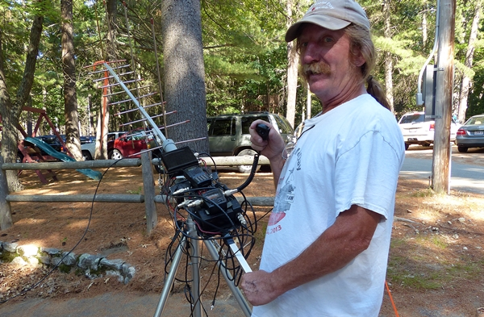
Satellite Station
Bob, KB1SWZ

Slide 74
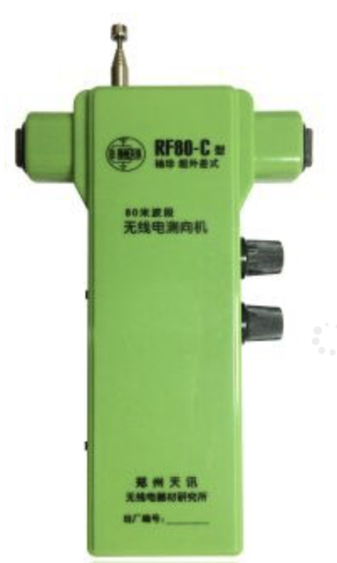
Fox Hunts
2 meter & 80 meter
Demos before lunch on Saturday
Bring your own gear or use ours

Slide 75
We Need
Antenna Crew
      Friday, June 21
      Noon to 6 PM (show up any time)
      At least 12
Attendance Wrangler
Ambassadors
Cleanup Crew on Sunday

Slide 76
Safety Briefing
PART Field Day
2019
Credits to Steve N1BDA (2016)
Since 2017 Dale KB1ZKD

Slide 77
What’s New?
This year
  Not much but we can be better in practice
  Minor edits and improvements in the brief
FD Safety Officer was new in 2016
Safety Officer recognition by ARRL
  100 bonus points
  Formal checklist

Slide 78
Checklist (1)
SO (or asst.) on site for entire event
Fuel for generators properly stored
Fire extinguisher on hand at each location
First Aid kit(s)
First Aid, CPR and AED trained participant/s on site for full Field Day period (Send me an email please)
Access to NWS alerts to monitor for inclement weather

Slide 79
Checklist (2)
Tent stakes properly installed and marked
Temporary antenna structures properly secured and marked
Site secured from tripping hazards
Site set up in a neat and orderly manner to reduce hazards
Stations and equipment properly grounded
Access to means to contact police/fire/rescue if needed

Slide 80
Checklist (3)
Safety Officer is designated point of contact for public safety officials (Need more assistants)
Minimize risks and control hazards to ensure no injuries to public
As necessary, monitoring participants for hydration and ensure an adequate water supply is available (but we can’t drink it for you.)

Slide 81
Safety Risks
Fires
Critters & plants: ticks, poison ivy
Weather: lightning, heat
Generators & fuel
Tripping hazards
Guy wires
Overhead wires
Antennas

Slide 82
Risk: Fire
Most likely sources are generators and kitchen
  Fire extinguisher locations (at each site)
  At first signs of fire, smoke, or burning odor alert folks, and call the Concord Fire Dept.
  911 (wired phone)
  Mobile: 978-318-3400
  Site: 446.025 MHz, simplex

Slide 83
Risk: Critters (1)
Bees, wasps, ticks, and mosquitos pose serious health risks
Mosquitos
  (treated) long pants & sleeves, light colors
  Repellant on skin (next slide)
Ticks
  (treated) long pants & sleeves esp. outdoors
  Check often (dark nooks and crannies)
Bees and wasps
  Carry your EpiPens and antihistamine pills (let folks around you know about potential problems)

Slide 84
Risk: Critters (2)
Skin treatment
  Be aware of other’s personal concerns (e.g. DEET)
  There are facts and data:
  https://www.cdc.gov/ncezid/dvbd/about/prevent-bites.html
  https://www.consumerreports.org/insect-repellent/how-safe-is-deet-insect-repellent-safety/
Clothing and gear treatment
  Permethrin works (read the precautions, use it correctly, pre-treat clothes and let them dry)
Check often
  Particularly in dark nooks and crannies

Slide 85
Risk: Weather
The primary danger is lightning
  It can occur miles from a storm under clear skies and up to 30 minutes after the storm “ends”
  We will monitor SKYWARN & NOAA radio
  All antennas will be disconnected during a storm and we will go inside
  Old school – counting seconds is a myth
  If you can hear thunder you are at risk - we will stop and go inside the club house

Slide 86
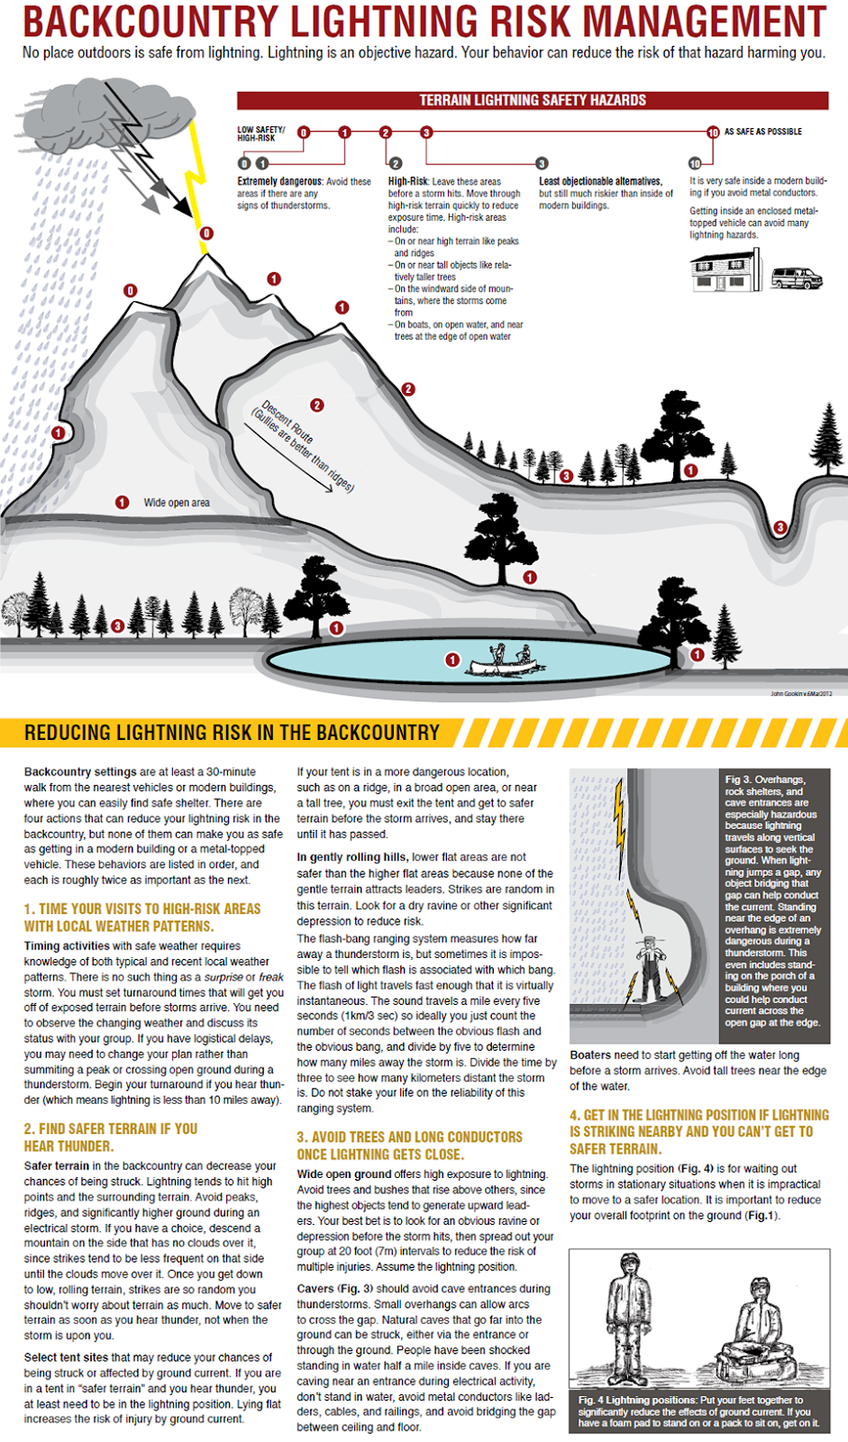
No place is “safe,”
But some are
Better than others

Slide 87
Risk: Weather (2)
Heat - dehydration is a risk
  There will be bottled water, but bring a water bottle (please) and use it
  Over hydration (hypernatremia) is also a risk
  “Clear and copious” means too much water
Cold – onset of hypothermia is the brain making bad decisions
  You can become hypothermic in warm weather. Don’t wait for shivering to start!

Slide 88
Risk: Generator
Primary danger is during refueling
  Shut down generator before refueling
  Extinguisher near each generator (Verify)
Secondary danger is electrocution
  Remember, it is 120VAC
  Exercise care plugging and unplugging cords, especially if wet

Slide 89
Risk: Slips & Trips
Cables, extension cords, guy wires
Cables (antennas, power,….)
  Taped down (indoors), pegged down
  Marked with colored flagging
Tent pegs
  Marked with colored flagging
Be careful entering and leaving the clubhouse – some steps are odd

Slide 90
Guy Wires:
Antennas & Tent
Be watchful around masts and poles
Avoid tent corners
Don't run
Guy wires marked with colored flagging
Danger areas flagged off

Slide 91
Risk: Overhead Wires
There are several around the grounds
Be careful during antenna setup
Note where the wires are, especially if you have a tall antenna on your vehicle
  Lower your antenna
  Find another route

Slide 92
Risk: Antennas
Line launchers: slingshots, arrows, and pneumatic “potato” guns
  Clear area down-range
  Be sure you have a safety observer
  Wear safety glasses
Ropes and wires
  Avoid fish lines, small cordage, ropes unless you are handling them
  Look overhead, not just in front of you

Slide 93
Don’t Be Deterred!
With all these dangers lurking, don’t be discouraged from participating
All these potential dangers can be managed if we are aware of them
Keys:
Common Sense (is rare)
Patience (is a virtue)

Slide 94
Potential Responders
(will have an on-site brief)
Name | Call | Current AED/CPR | Current First Aid Level
Dale Chayes | KB1ZKD | X | Wilderness First Aid, NOLS
Alan Hicks | KD1D | X | BLS, Red Cross
Colin Brench | W1DJR | X | Red Cross

Slide 95
Emergency Gear
Wired phone in the bar
Life Rings around the pond
AED in the clubhouse (bar area)
Trauma kits
  On me (Dale)
  Tan bag under the back seat of my van
  Above the driver’s visor in my van
Boo-boo kit (on you)

Slide 96
Your Safety Team
Dale Chayes – KB1ZKD
Alan Hicks – KD1D
Colin Brench – W1DJR

