Slide 1
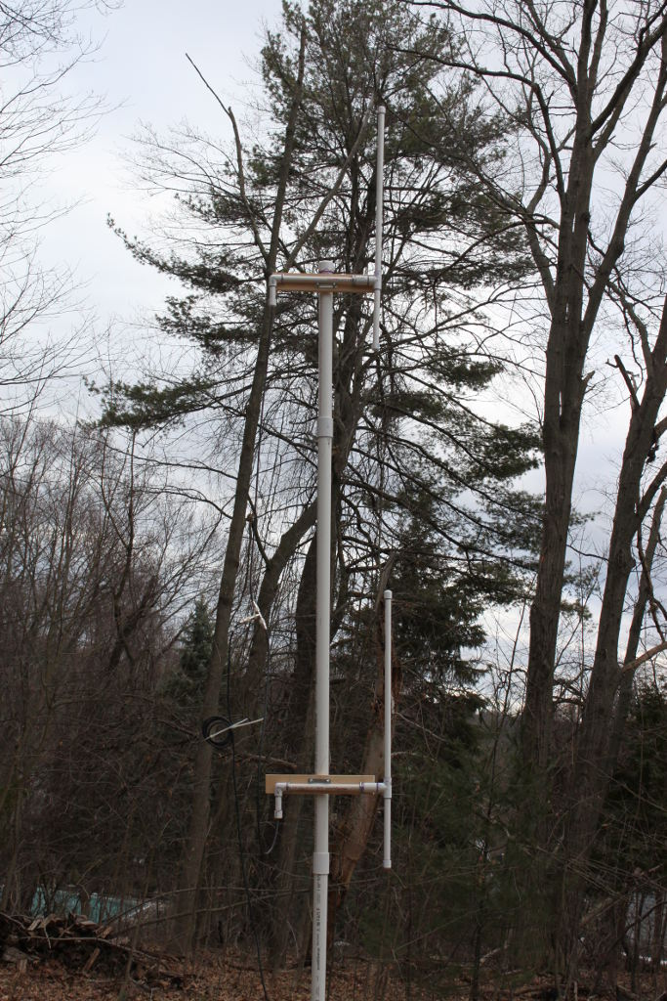
A 2 Meter 2 Element Collinear Antenna
Bob Rose
KC1DSQ
b.rose@comcast.net

Slide 2
Basic Structure
Two dipoles stacked vertically
Separated by .4 wavelengths (146 Mhz design frequency)
Each dipole is manipulated to have an impedance of 100 Ohms by feeding it off center.
Each dipole has a one wavelength feed cable
Dipoles are connected together with a UHF Tee

Slide 3
Built With 1/2” Schedule 40 PVC Pipe and #16 Wire
PVC has a dielectric constant of 3
1/2” Schedule 40 pipe has a wall thickness of .109
Simulated in EZNEC
Resonance length is shortened to 34.75”
Impedance at resonance is reduced to 59 Ohms
Using a small wire gauge reduced the impedance by a few Ohms

Slide 4
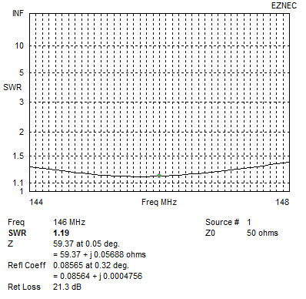
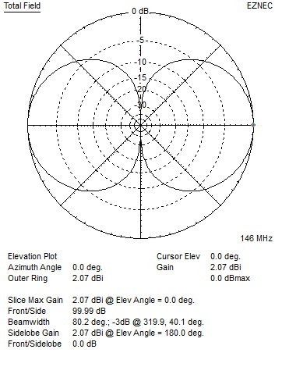
A Center Fed Dipole Built This Way is a Decent Antenna

Slide 5
Impedance From Off Center Feed
Note center fed impedance is 59 Ohms
Feed point at 26% gives 100 Ohms
Short side is 9.125”, Long side is 25.625”

Slide 6
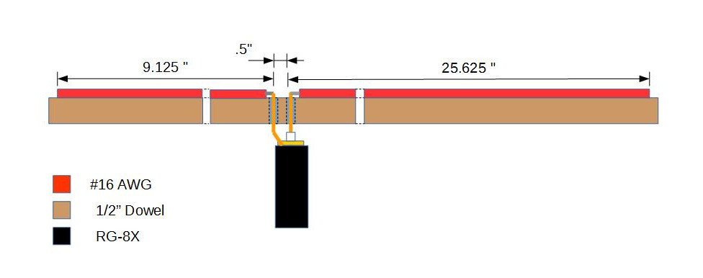
Construction Details
Elements are #16 AWG wire
Supported by 1/2” dowel
Uses the Handyman's Secret Weapon: Duct Tape

Slide 7
Dipole Feed Line
100 Ohm coax exists (RG-180) but costs $3/ft
Used one wavelegth of 50 Ohm cable (RG-8X)
Multiples of ½ wavelength transfer the impedance at the near end to the far end
RG-8X has a Vf of 78%, Wavelength is 80.8415”
One wavelength cable is cut to 63”

Slide 8
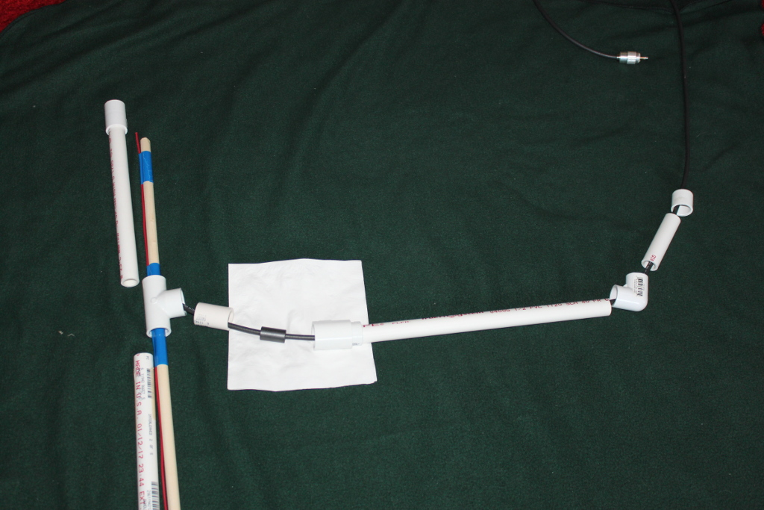
Exploded View of Dipole

Slide 9
Tuning
Dipole is dry assembled and tested
Looking for 100 Ohms at 146 Mhz
Frequency was a little low and impedance was a little high
I trimmed about an inch off of the long side
The dowel is dielectric material not modeled in EZNEC

Slide 10
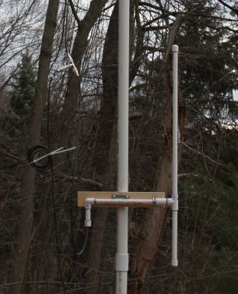
Assembled Dipole

Slide 11
Assembled Antenna

Slide 12
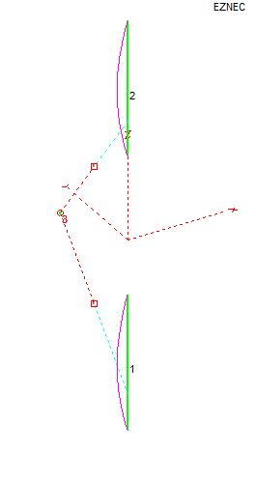
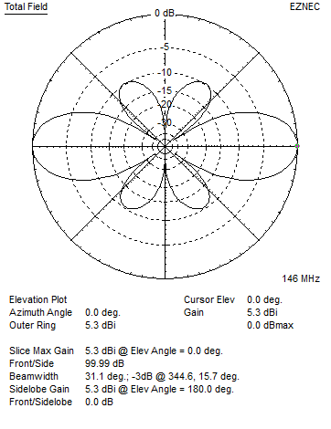
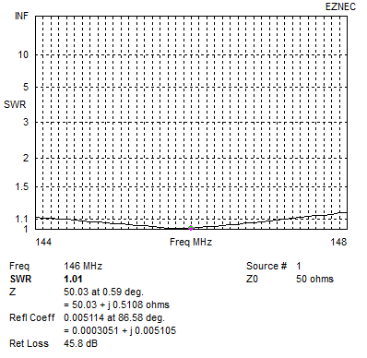
Simulation Results

Slide 13
Measured Results
The Antenna Analyzer was connected directly to the Tee
Frequency | SWR
144 | 1.0
145 | 1.0
146 | 1.0
147 | 1.0
148 | 1.1

